Slide 1

Ph.D. Recruitment Event
November 1, 2023

Slide 2
ROSEI Founded in 2021
The Ralph O’Connor Sustainable Energy Institute (ROSEI) integrates multi-disciplinary efforts across the university to
  create and implement clean, renewable and sustainable energy technologies;
  educate future energy leaders;
  support implementation, markets, and policies that promote an affordable and equitable green energy future for a more resilient world.
Values: Innovation, Education, Equity, Community

Slide 3









ROSEI Research Pillars and Cross-Cutting Areas
Carbon
Storage/Solar
Wind
Grid
Community
Education
Policy
Translation

Slide 4
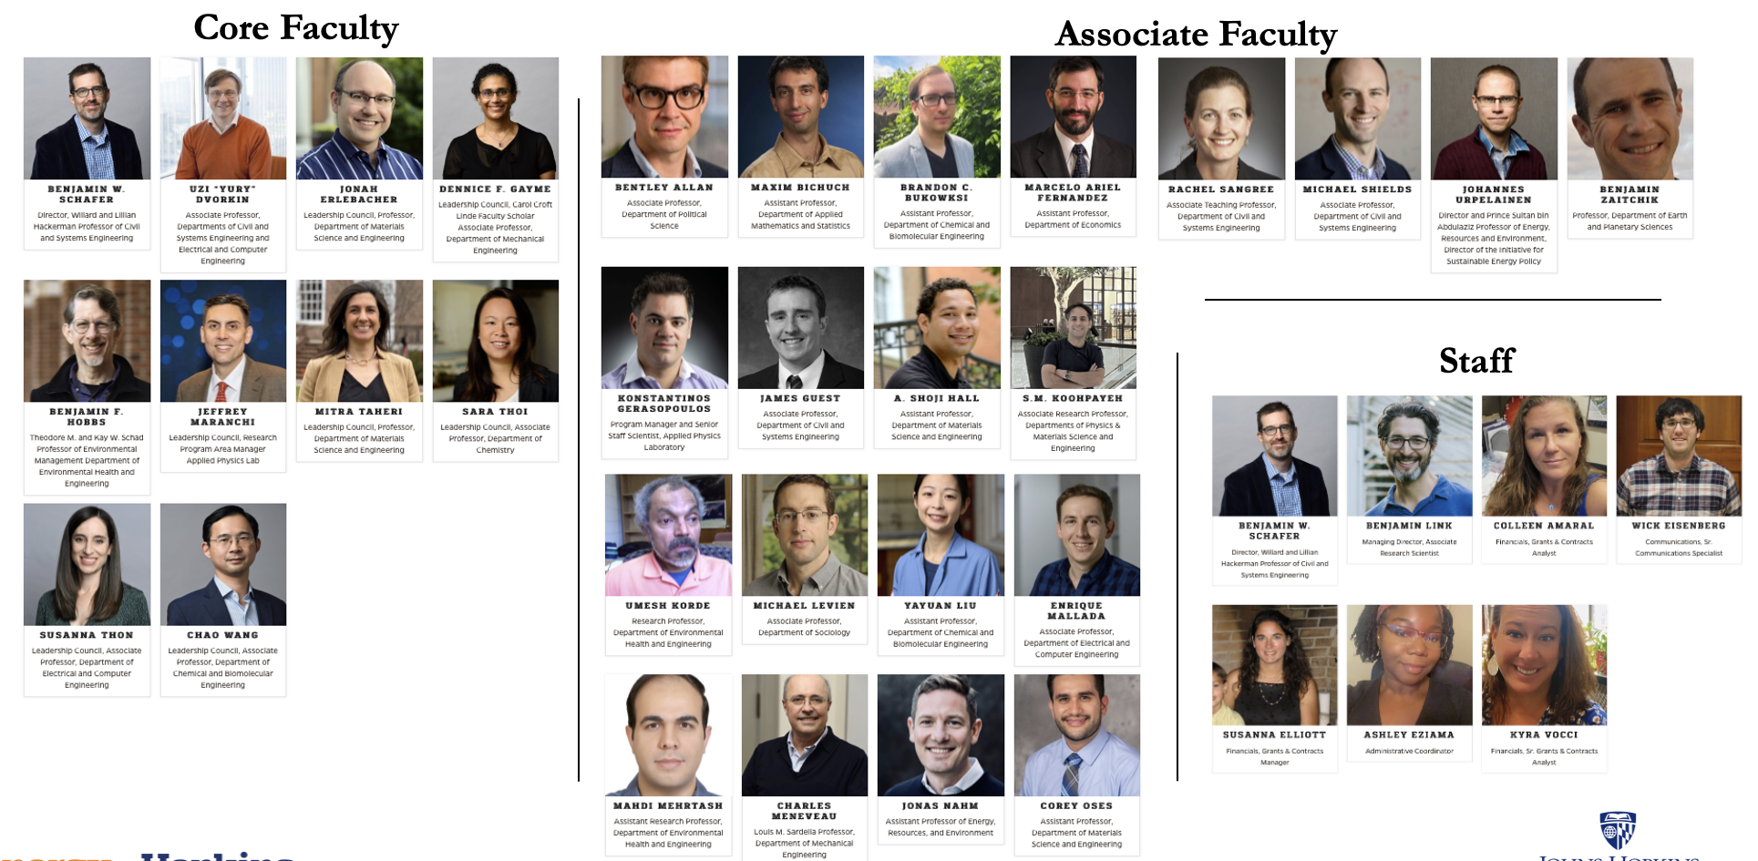

ROSEI People
WSE departments: AMS, CBE, CaSE, ECE, EHE, Mat Sc, MechE
KSAS departments: Chem, Econ, Political Sc, EPS
SAIS

Slide 5
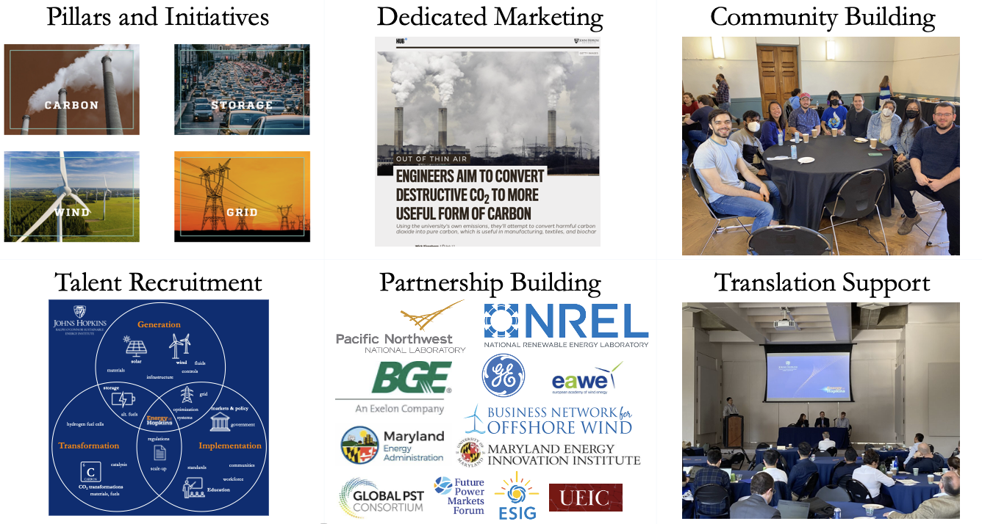
ROSEI Activities
ROSEI Annual Summit:
  Every January
  100+ presenters
  Program in 2023: see here
  Event in 2024: see here
ROSEI Translation Event:
  Every Fall (last on Oct 30)
  See the program here

Slide 6
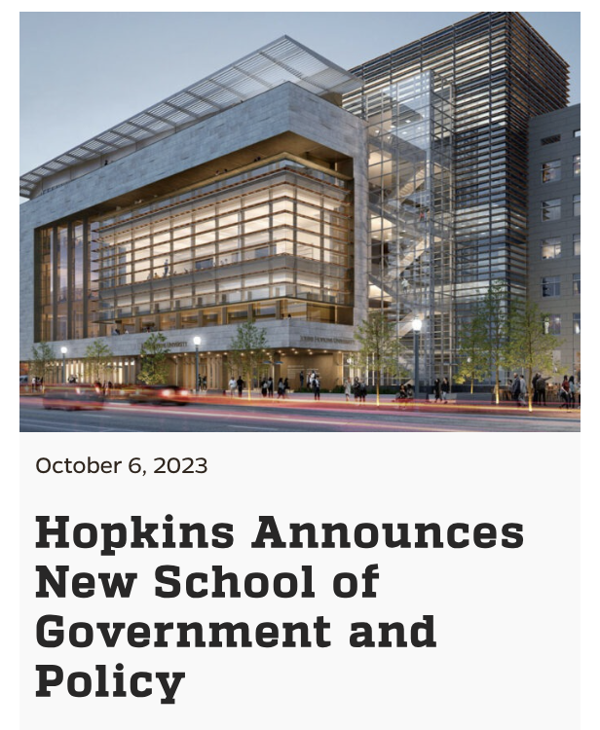
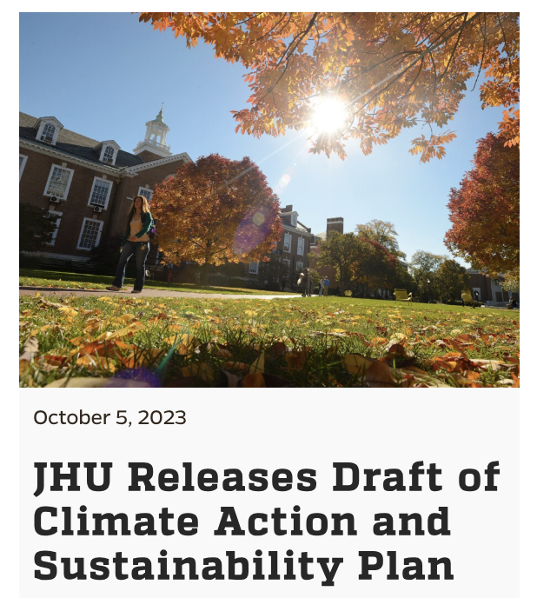

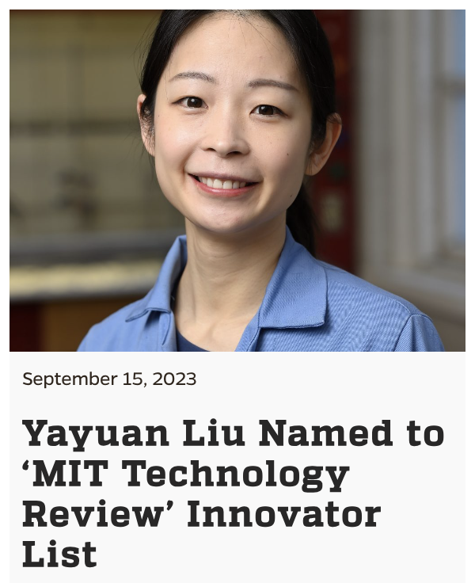
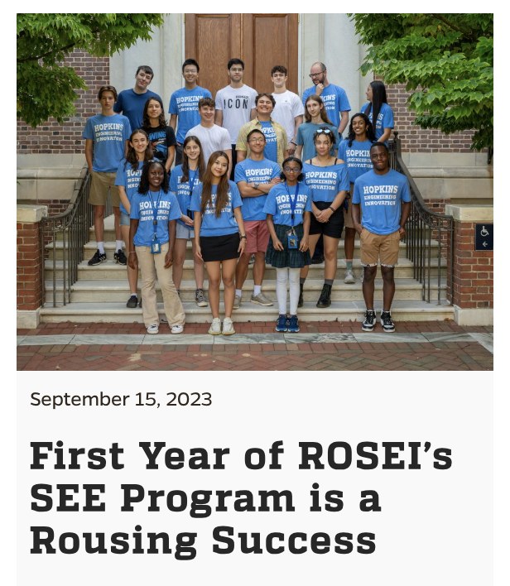
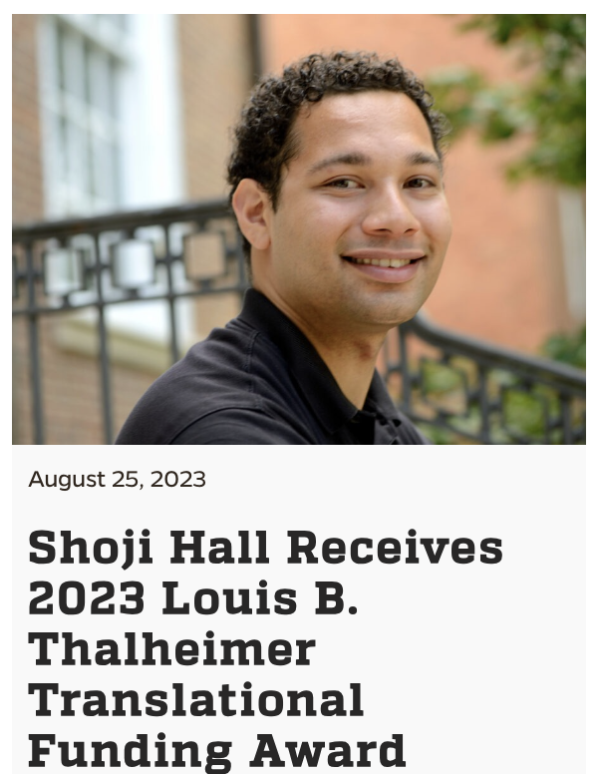
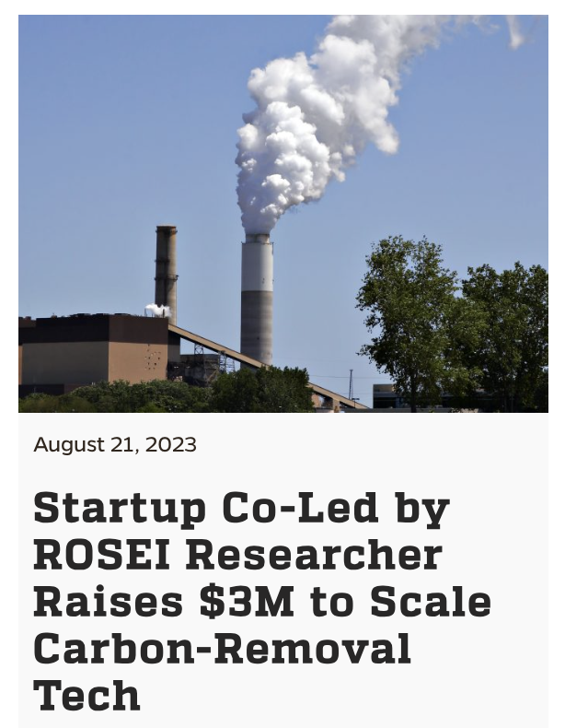
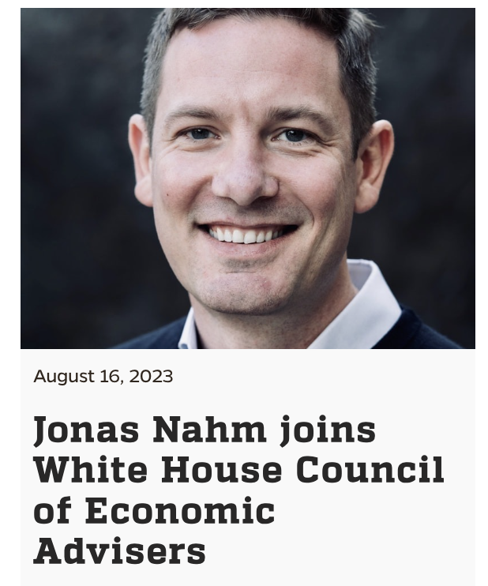
ROSEI: Recent Activities (Aug’23 – onwards)

Slide 7
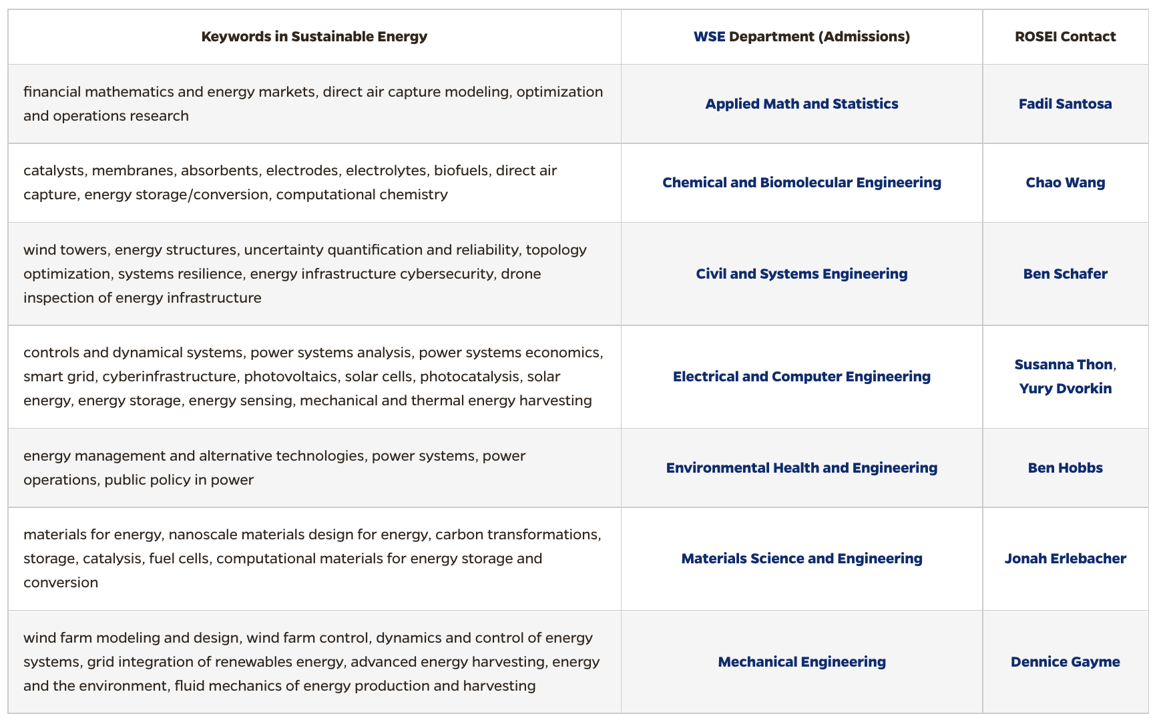
Participating WSE Departments
Also, feel free to reach out to area contacts for any questions
fsantos9@jhu.edu
chaowang@jhu.edu
schafer@jhu.edu
susanna.thon@jhu.edu
ydvorki1@jhu.edu
bhobbs@jhu.edu
Jonah.Erlebacher@jhu.edu
dennice@jhu.edu
More information (including emails): https://energyinstitute.jhu.edu/doctorate-programs-in-sustainable-energy/

Slide 8
Admission at WSE Departments
Admission is administered via departments
Requirements and process may differ across departments
Faculty make nominations, but departments need to approve them
Some extra comments:
  We do not have Ph.D. entrance exams
  Some departments do rotation, some departments don’t
  Ph.D. students are typically supported via a combination of fellowships and research grants
    Tuition waiver
    Stipend
    Health benefits
  Collaboration between multiple faculty is encouraged

Slide 9
Application Requirements in WSE
ROSEI students are also part of respective departments
  Your degree is awarded by the department
Deadlines are soon
  Dec 1, 2023: EHE
  Dec15, 2023: AMS, CBE, CS, Mat Sc, MechE
  Dec 22, 2023: ECE
  Dec 31, 2023: CaSE
GRE is NOT required for Ph.D. applications
  Can self-report GRE scores
TOEFL is required for international students (100+ on iBT)
Application fee is $75 and can be waived in many eligible cases (the waiver is part of application)
Review program-specific requirements, which may differ
More information: https://engineering.jhu.edu/admissions/graduate-admissions/full-time-programs/how-to-apply/application-deadlines/

Slide 10
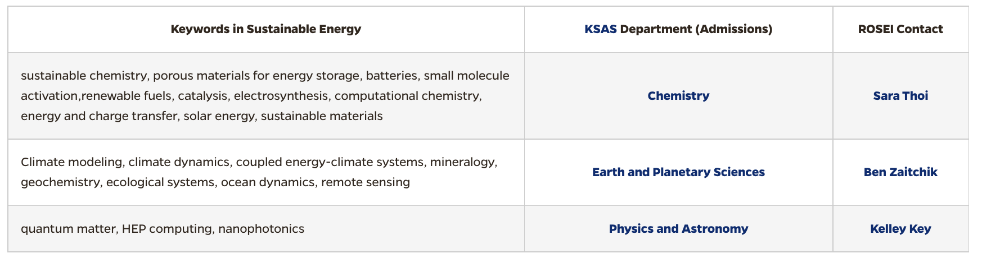
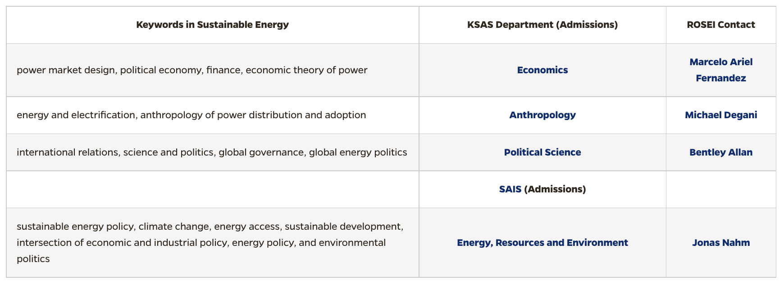
Other Participating Schools
Also, feel free to reach out to area contacts for any questions
sarathoi@jhu.edu
zaitchik@jhu.edu
kkey1@jhu.edu
fernandez@jhu.edu
mdegani1@jhu.edu
bentley.allan@jhu.edu
jnahm@jhu.edu
More information (including emails): https://energyinstitute.jhu.edu/doctorate-programs-in-sustainable-energy/

Slide 11
Support for Ph.D. students
Ph.D. students are financially supported
  Department-specific arrangements
  Flexibility in choosing advisors
A large number of fellowships
  Across WSE, Departments & Centers
  Vivian Thomas Scholars Initiative for MSI and HBCU graduates (due on Dec 1, 2023)
  Percy Pierre Fellowship
  GEM Fellowship
    Hopkins-specific internship program
More information about the fellowships: https://engineering.jhu.edu/education/graduate-studies/full-time-graduate-fellowships-grants/

Slide 12
Admission
Also, feel free to reach out to area contacts for any questions
sarathoi@jhu.edu
zaitchik@jhu.edu
kkey1@jhu.edu
fernandez@jhu.edu
mdegani1@jhu.edu
bentley.allan@jhu.edu
jnahm@jhu.edu
More information (including emails): https://energyinstitute.jhu.edu/doctorate-programs-in-sustainable-energy/

Slide 13

Vivian Thomas Scholars Initiative
■ Must apply by December 1, 2023
■ Complete PhD application and VTSI supplemental application
■ Offers 6 years of support
■ Must have attended eligible MSI or HBCU
https://provost.jhu.edu/about/vivien-thomas-scholars-initiative/
Your perspective matters—to our programs, our community, and our world.
We believe that exchanging ideas with people from different backgrounds and disciplines makes everyone’s work more dynamic and impactful, at every level.
At Johns Hopkins University, you’ll be empowered to share your unique experiences and grow in discovery on your path to becoming a leader
in your field.
”
MORE INFORMATION AVAILABLE AT JHU.EDU/VIVIEN-THOMAS

Slide 14
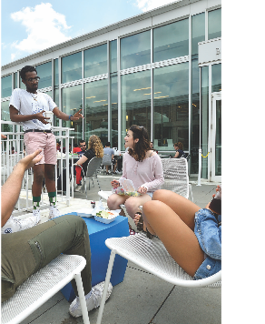
Percy Pierre Doctoral Fellowship
The Percy Pierre Doctoral Fellowship was established to recognize outstanding incoming doctoral students who will uniquely contribute to the intellectual life of the department and our broader graduate community.
■ Offers two years of support
■ Selected by department and Dean’s office
■ Flexibility in choosing research area/topic
■ Option of completing lab rotation
■ Enhanced mentorship and advising
■ Community building and networking
■ Leadership and career development

Slide 15
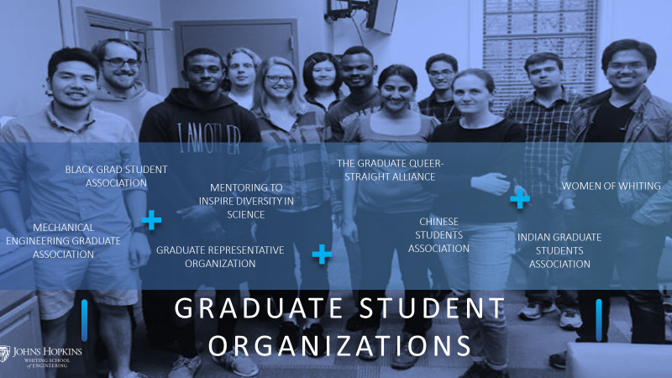
Student Organization

Slide 16

Living in Baltimore
JHU helps find housing to students
  Check out options and FAQ: https://offcampushousing.jhu.edu/
Zagat ranked Baltimore the #2 Food City in the U.S.
Entrepreneur magazine rated Baltimore one of the nation’s Hot Startup Cities last year
Explore Artscape, HONfest, a world-class aquarium, the Inner Harbor, museums, and many vibrant neighborhoods and historic districts
Home to two Major League sports teams and the Baltimore Marathon
Close proximity to Washington D.C., Philadelphia, and ocean beaches
Outdoor recreation includes the Appalachian Trail, local and state parks, and Chesapeake Bay
More information: https://engineering.jhu.edu/student-life/living-in-baltimore/

Slide 17
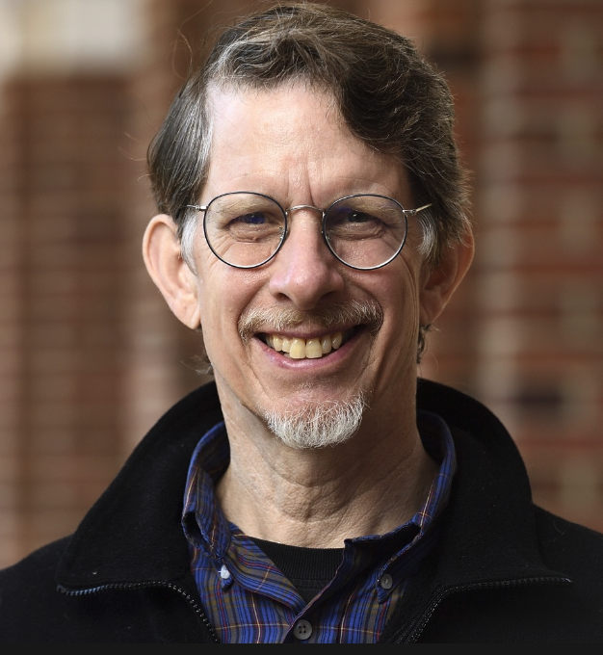
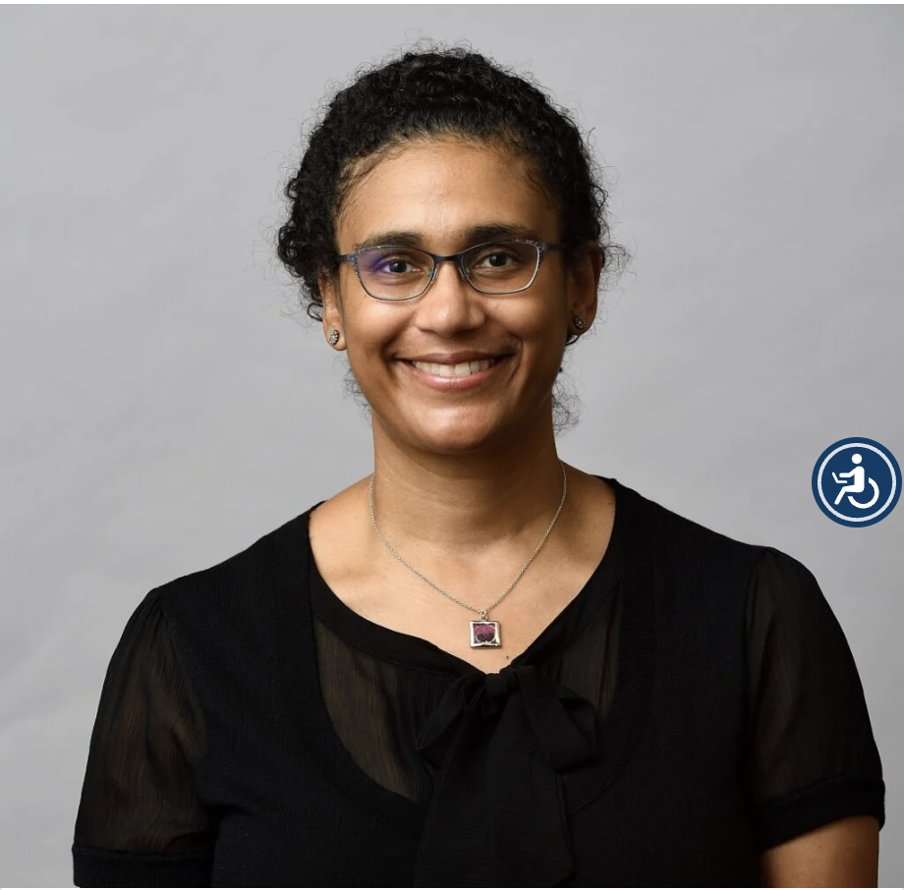
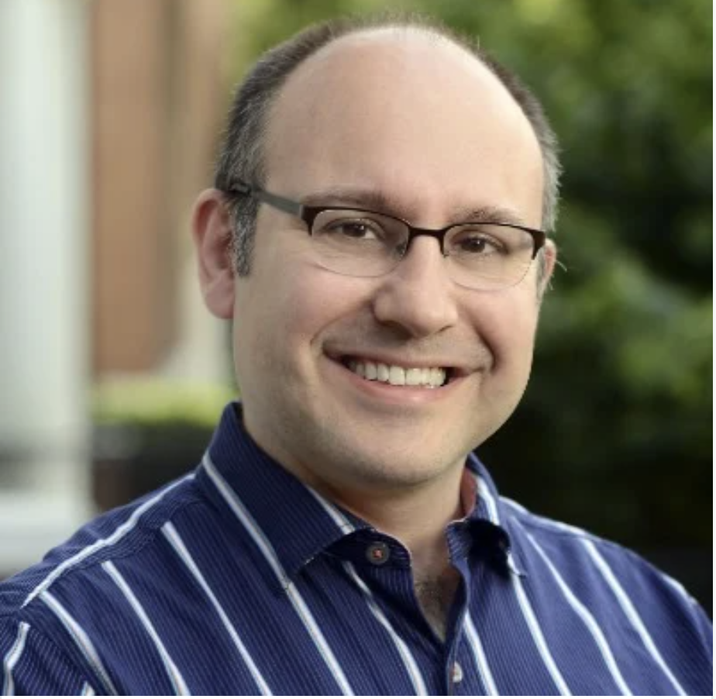
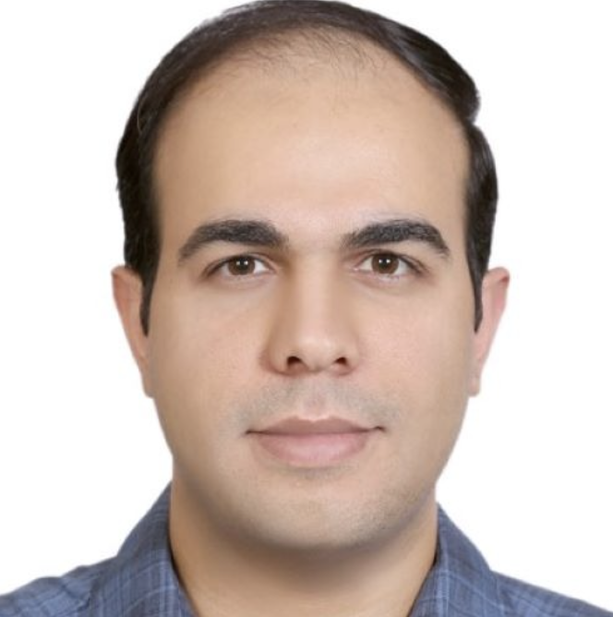
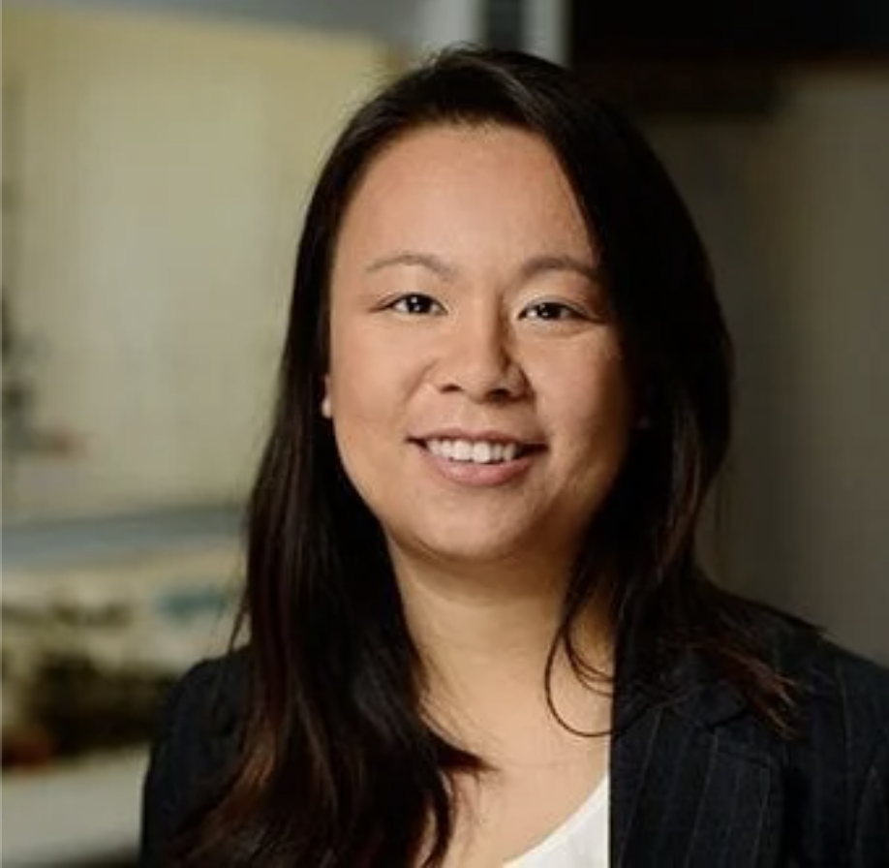
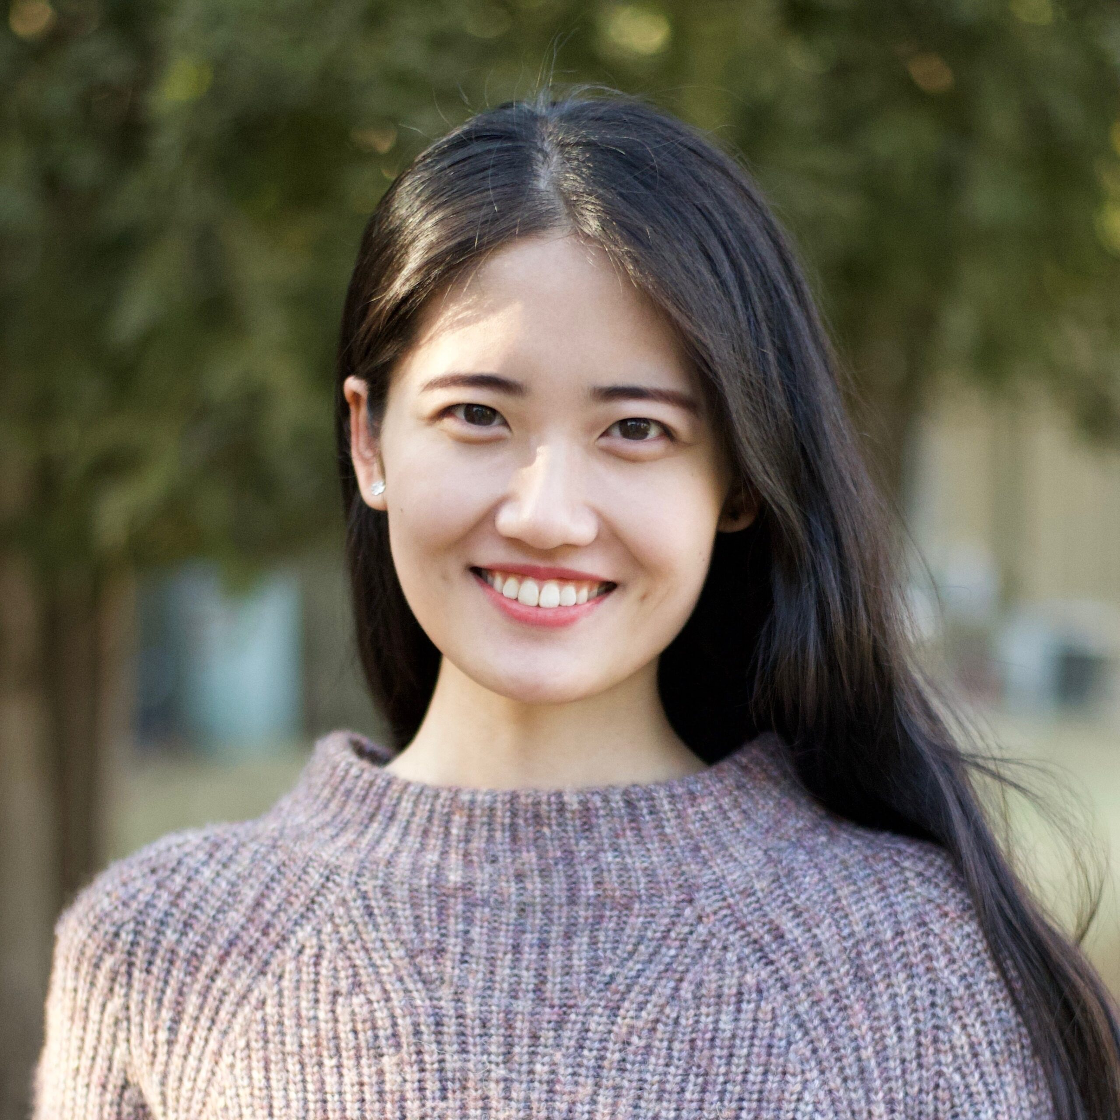
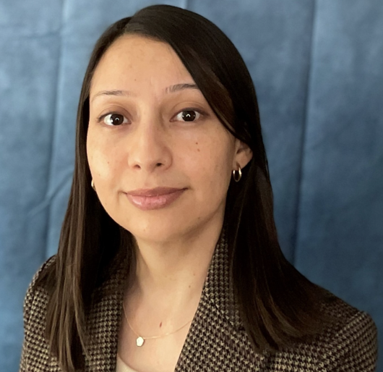
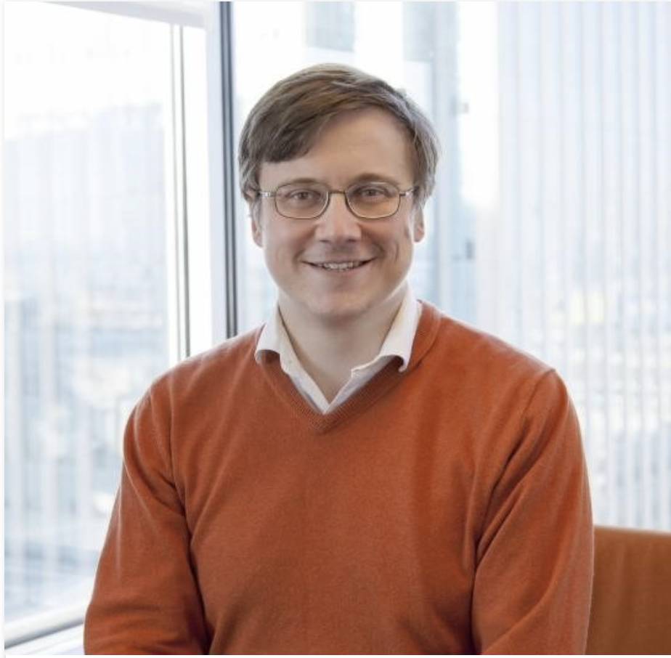
Today’s Panel
Benjamin Hobbs,
EHE (Grid)
Dennice Gayme, Mech (Wind/Grid)
Jonah Erlebacher, Materials (Carbon)
Mahdi Mehrtash, EHE (Grid)
Sara Thoi, Chem
(Storage)
Sijia Geng, ECE
(Grid)
Regina Garcia-Mendez,
Materials (Storage)
Yury Dvorkin, CaSE and ECE (Grid)

Slide 18
Live Q&A session!

