Slide 1

ROSEI Overview

Slide 2
ROSEI Founded in 2021
Vision: Johns Hopkins University is globally recognized for developing technologies, educating people, and supporting policy that equitably addresses the intertwined challenges of climate change and energy use for Baltimore, the nation, and the world.
Mission: The Ralph O’Connor Sustainable Energy Institute (ROSEI) integrates efforts across the university to create and implement clean, renewable and sustainable energy technologies; educate future energy leaders; and within the complex inter-connected systems that energy resides support implementation, markets, and policies that promote an affordable and equitable green energy future for a more resilient world.
Values: Innovation, Education, Equity, Community

Slide 3

JHU Divisions

Slide 4
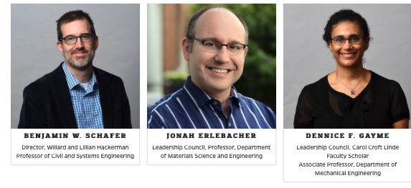
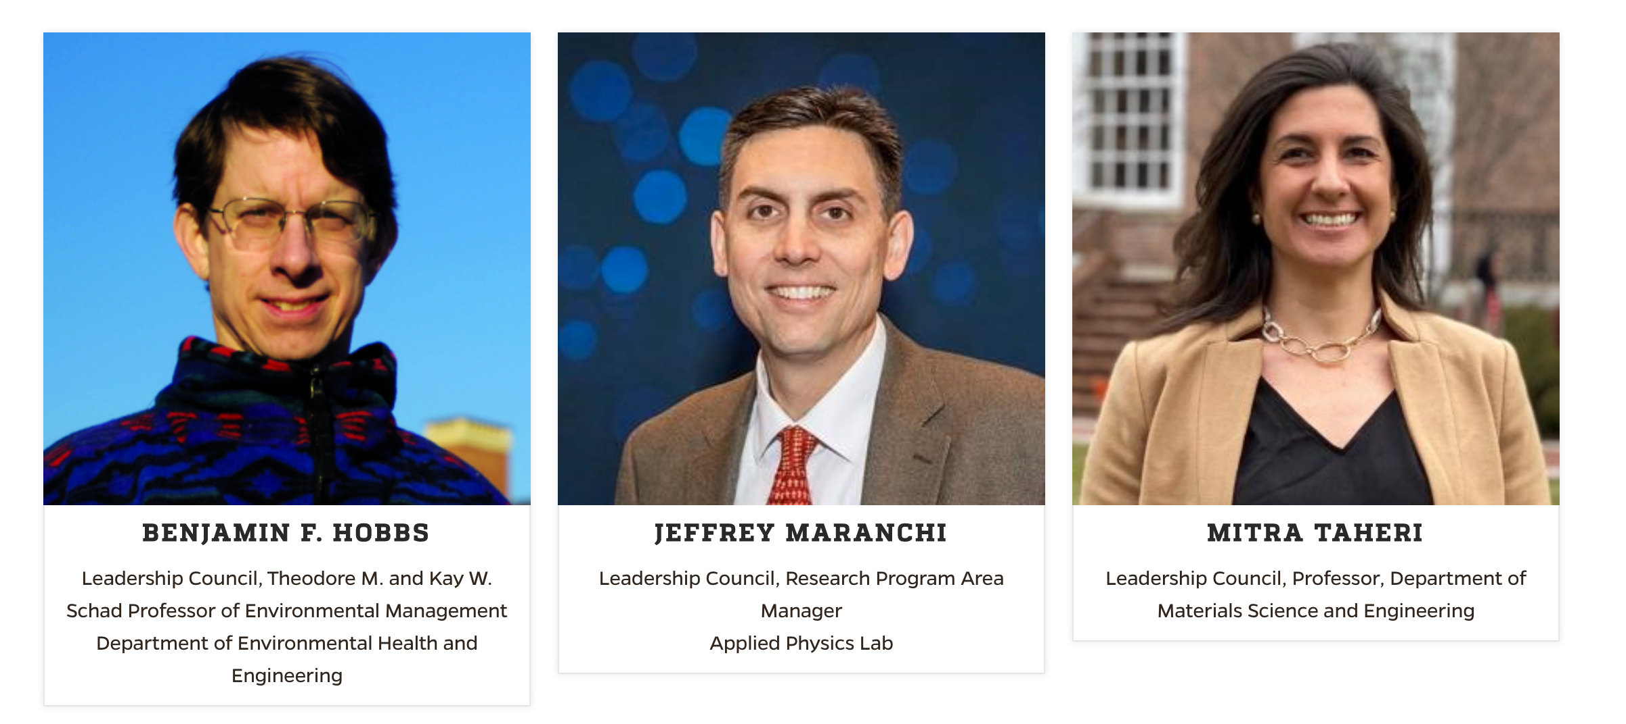
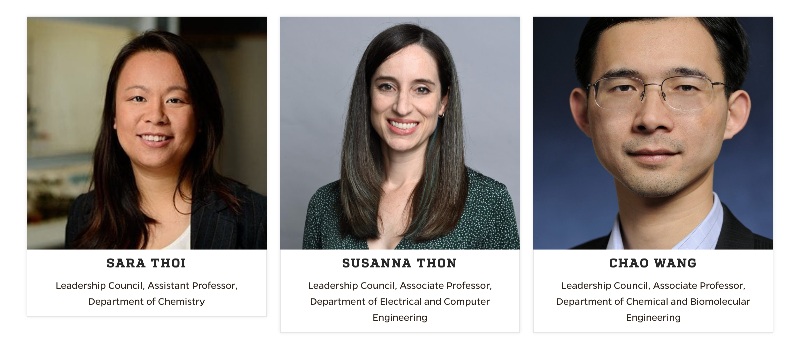
ROSEI Leadership Council
ROSEI Faculty
10 Core Faculty
16 Associate Faculty
35 Affiliates

Slide 5
Broad view of ROSEI Faculty Expertise:
Engineers
Chemical Eng, Materials Science, Electrical Eng., Mechanical Eng., Civil Eng., Systems Eng., Env. Eng., App. Math
Scientists
Chemistry, Earth Sciences, Physics
Social Scientists
Economics, Political Science,
Sociology, Anthropology

Slide 6
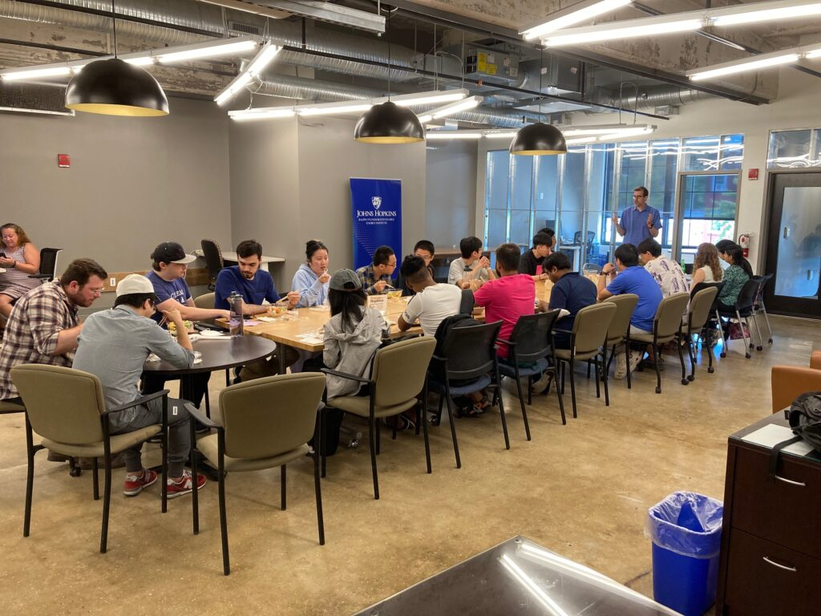
ROSEI Activities & Operations
Research Pipeline
4 Research Pillars
Building Community
Translation to Markets
Talent Recruitment
(Faculty, Staff and Students)
Partnerships
Communications and Promotion

Slide 7


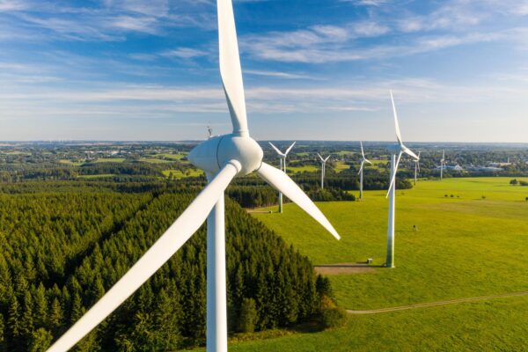
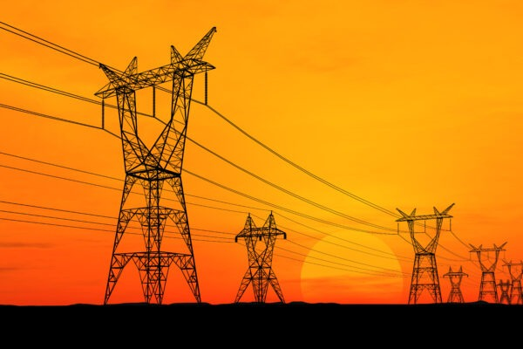





ROSEI Research Pillars and Cross-Cutting Areas
Carbon
Storage
Wind
Grid
Community
Education
Policy
Translation

Slide 8




Carbon
Chemical and materials transformations to capture,
upcycle, and repurpose carbon
ROSEI researchers focused on translation
of technology to the market,
example new companies

Slide 9


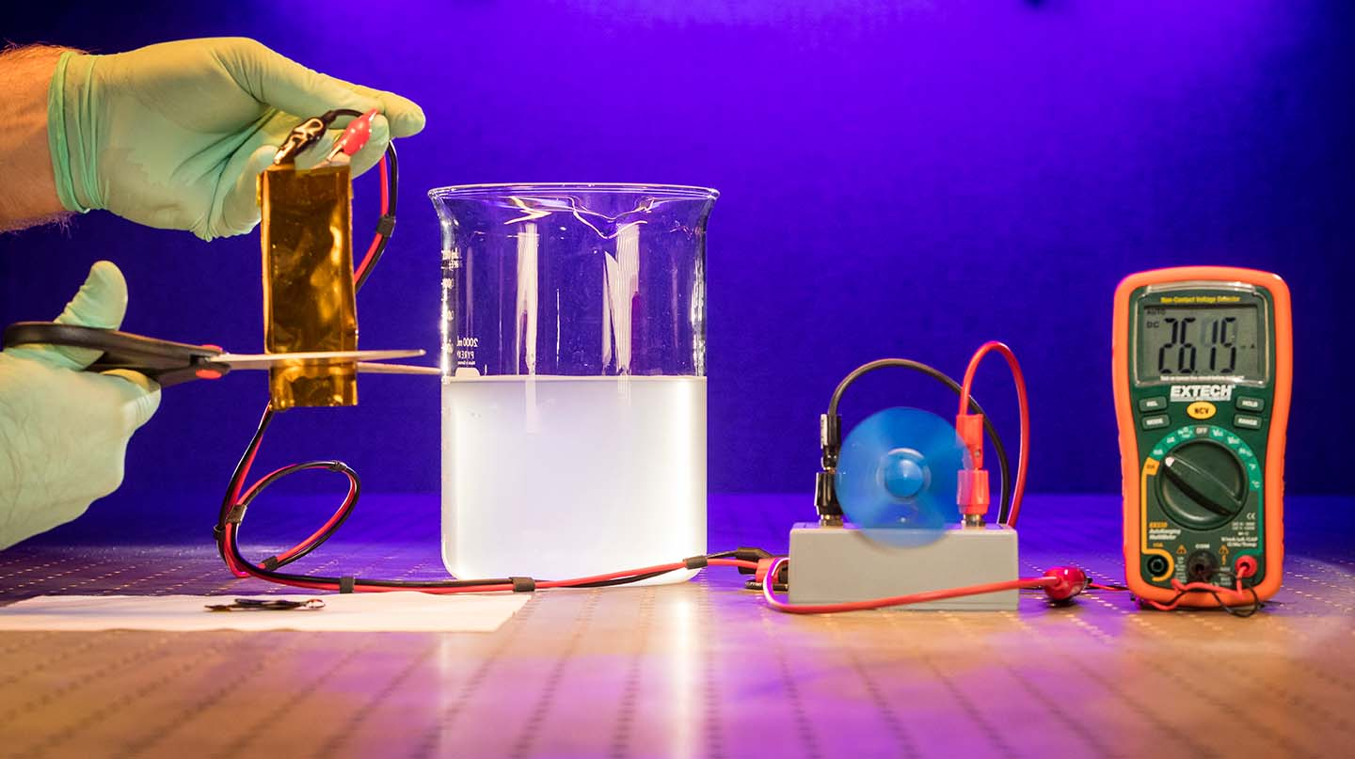

Storage
Chemistry, materials, and electrical engineering to create
integrated (e.g. with solar), sustainable, and safe energy storage.
ROSEI researchers focused on next generation
solid state technologies and minimizing use of rare
earth metals.
Battery cut, and continues
operation (APL)

Slide 10
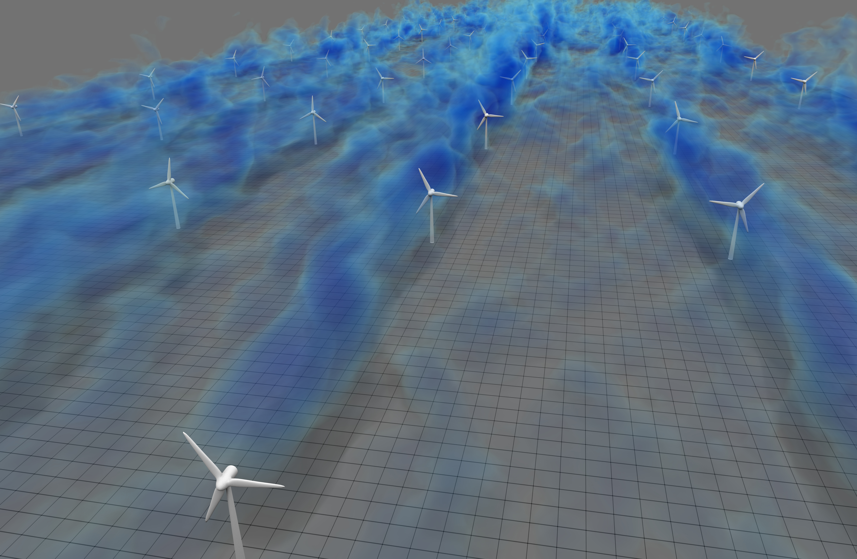




Wind
Atmospheric science, fluids, electrical
mechanical, and civil engineering for
efficient, scaled, reliable, renewable
power
ROSEI researchers work with national
labs and major OEMs to advance
controls, towers and solutions that
scale today for global needs
ROSEI wind farm simulation

Slide 11





Grid
Power engineers, systems engineers, economists
and policymakers working towards full
electrification with renewable power and a transformed grid
ROSEI researchers established an NSF global climate change center and partner with ISOs to supply engineering and market solutions for a massively scaled up and dynamic power grid to deliver reliable power in an equitable fashion
NSF Global Center
Electric Power Innovation
for a Carbon-free Society

Slide 12
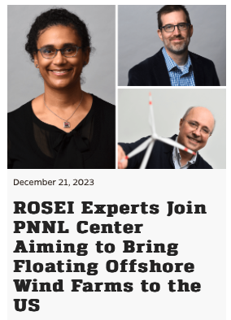
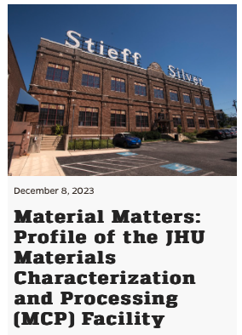
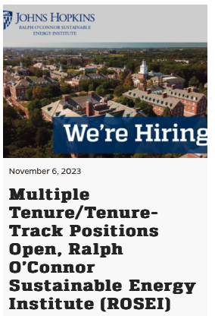
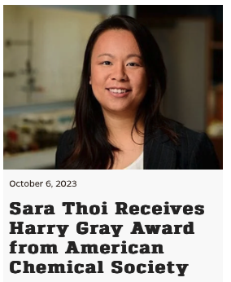
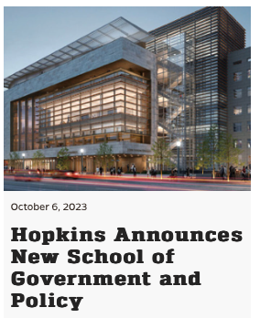
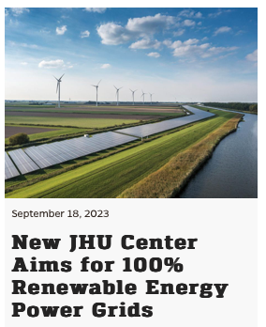
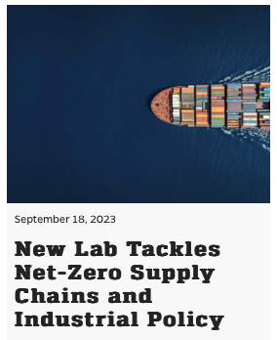
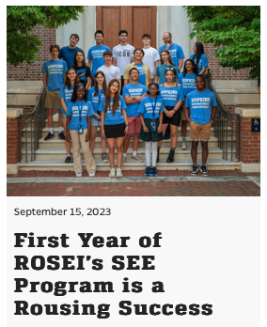
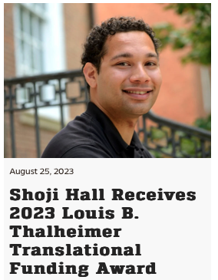
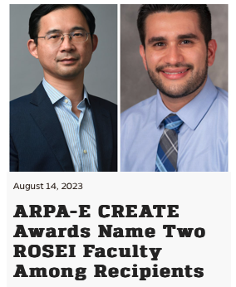
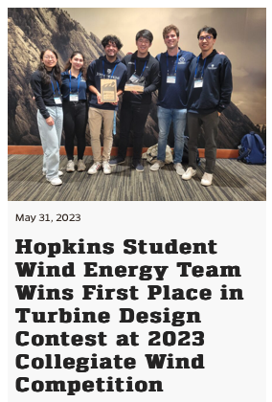
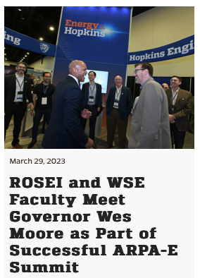
ROSEI Awards, People, Events & More

Slide 13
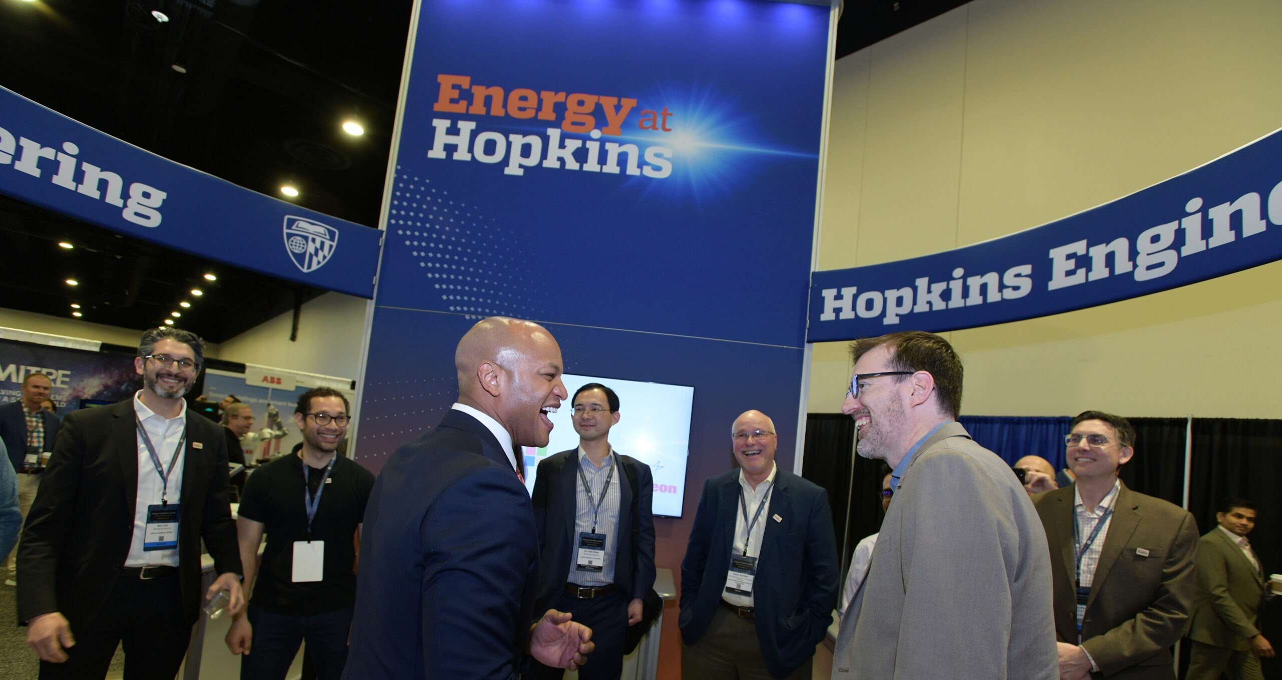
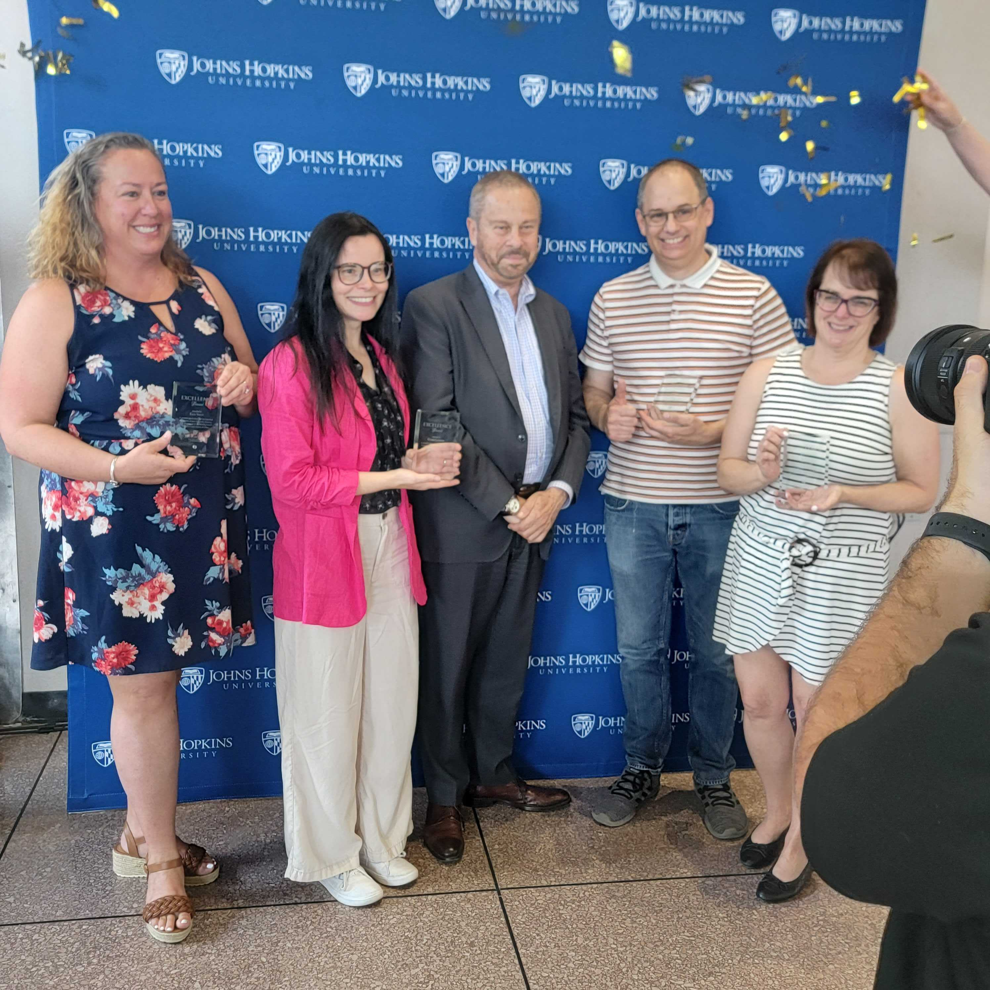
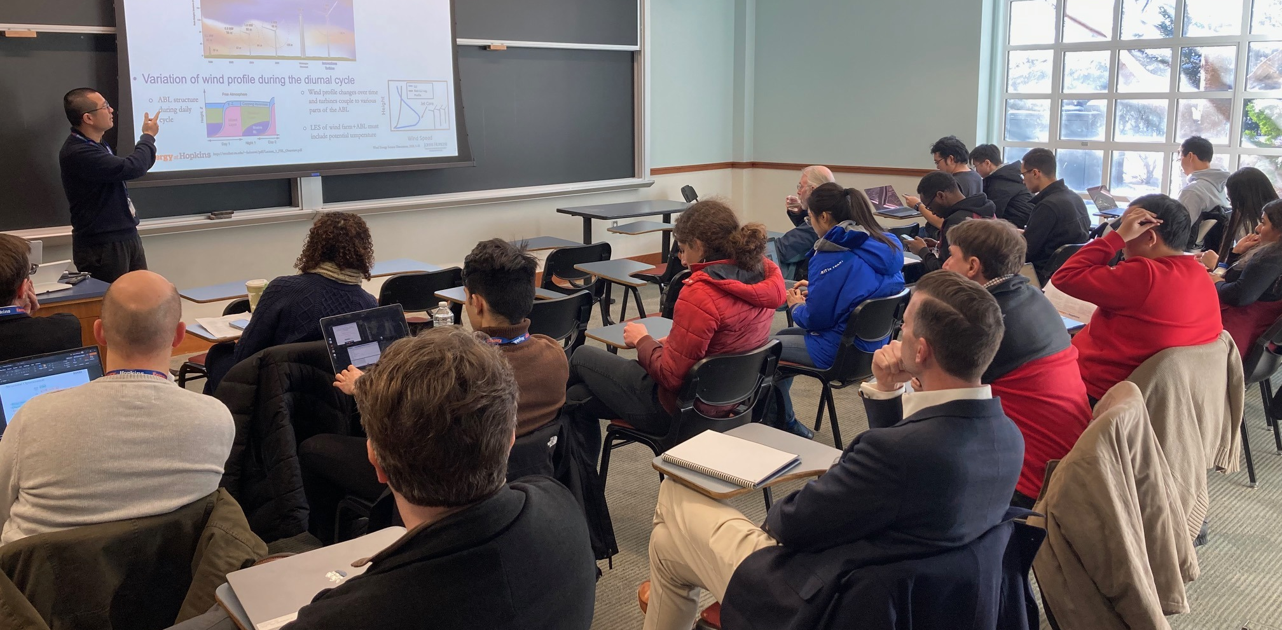

Slide 14
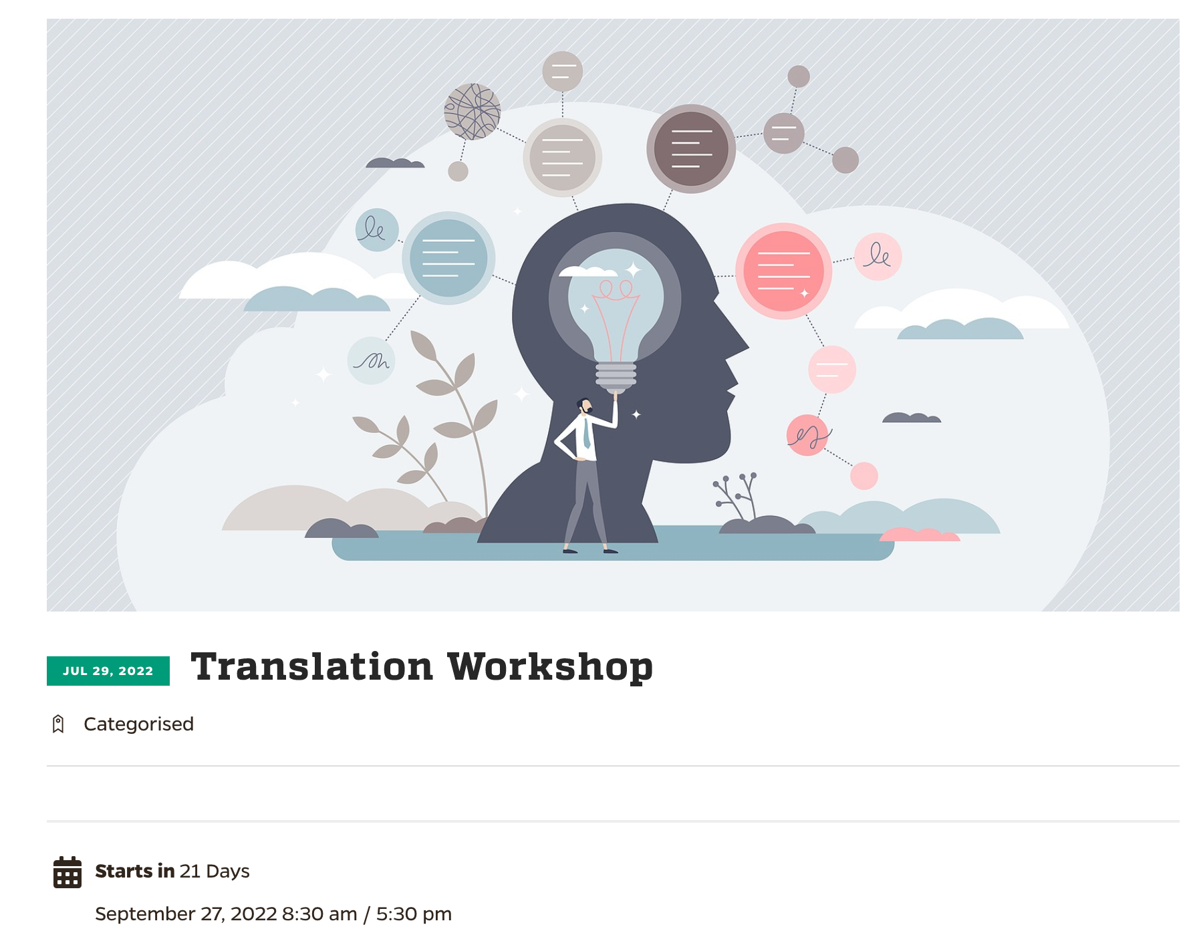
ROSEI: Translation Focus
General bias toward pushing science/engineering innovation toward solution sets
Educating and resourcing faculty for translation efforts
Kickoff T2M event on Sept 27 together with Johns Hopkins Tech Ventures

Slide 15













Partnerships
ROSEI’s Leadership Council performed an initial strategic planning exercise to identify and select priorities for key strategic partners (beyond funding agencies). External partnerships may shift significantly over time in response to funding opportunities, current engagement*:
National Labs
Corporate
Associations, NGOs
Government
Consortiums
2022-2023 Focus Partners
*Meetings, research collaborations, letters of support, developing exchanges, etc.
Note, individual faculty in ROSEI connect to wider sets…

Slide 16
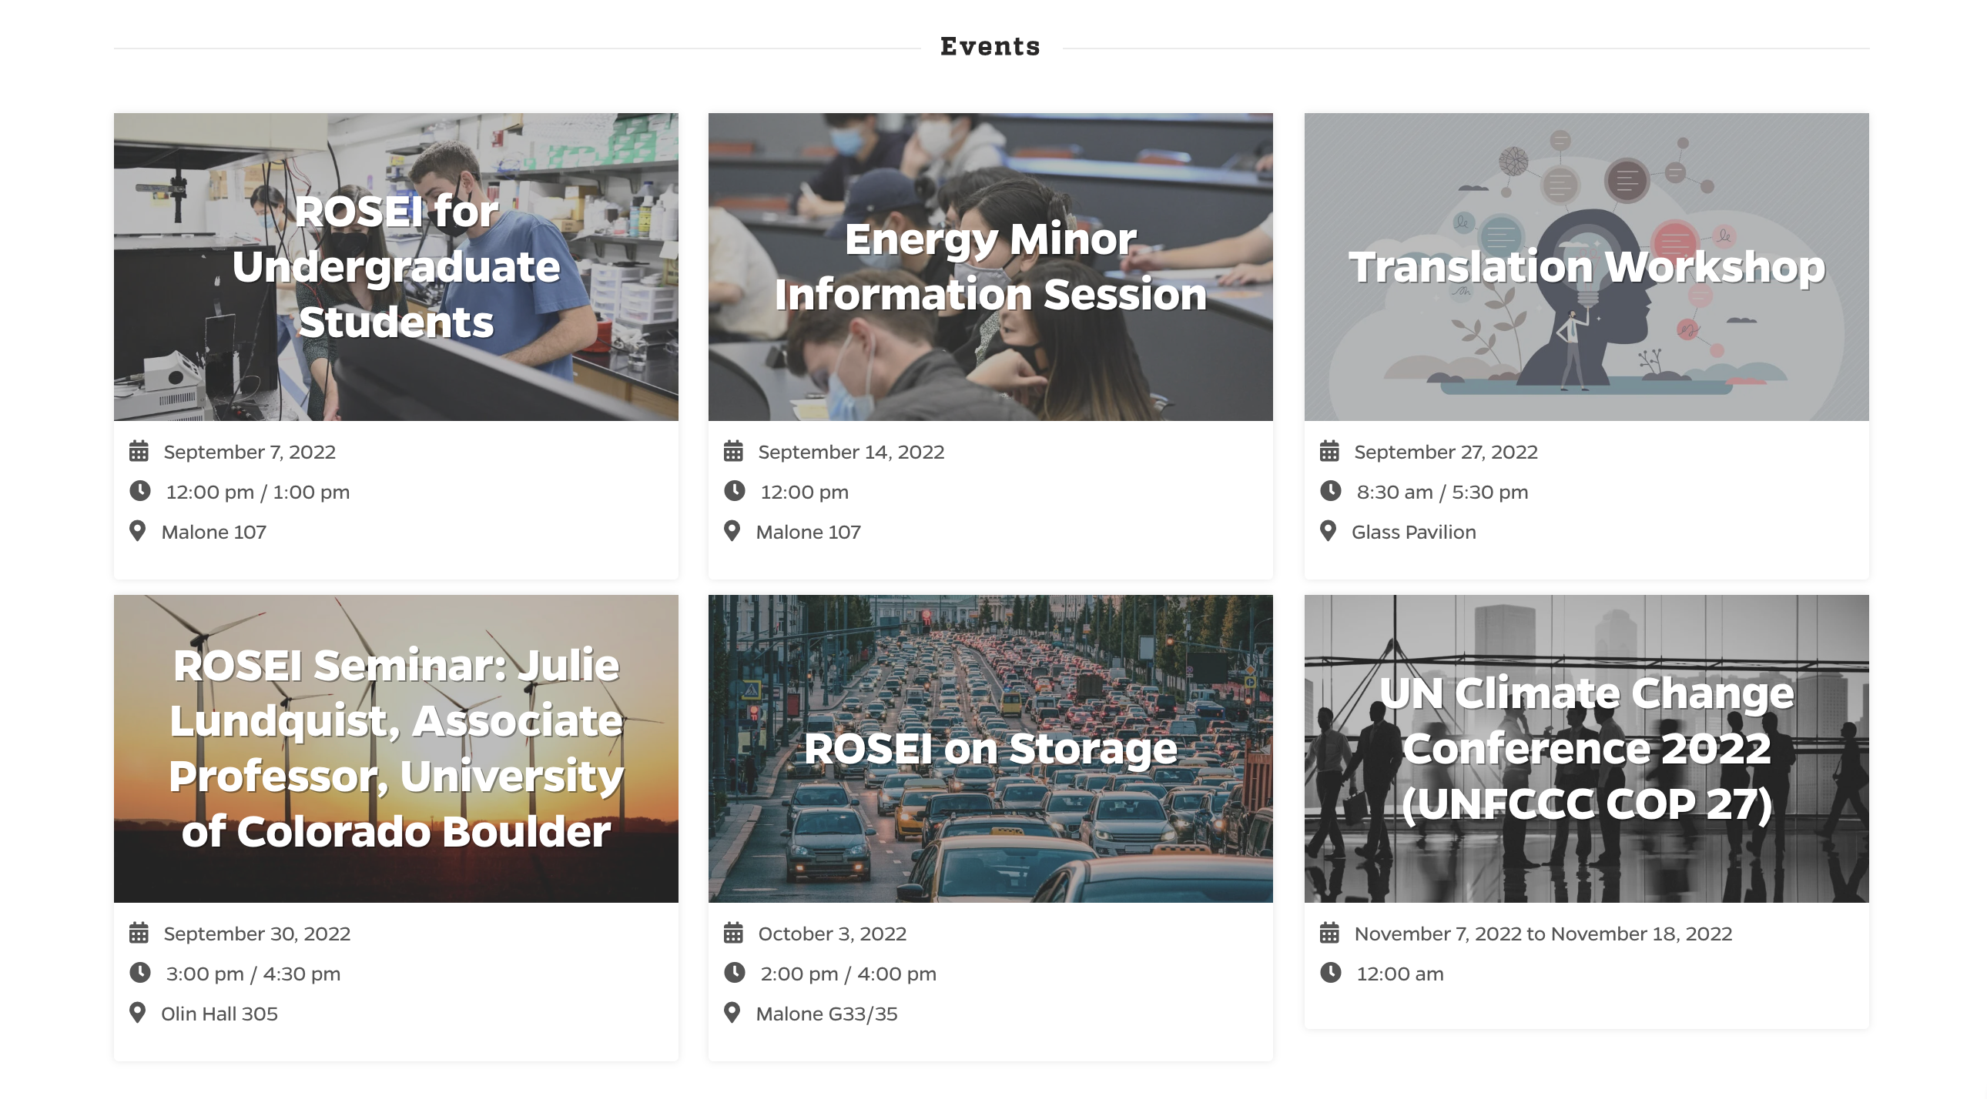
ROSEI Community Building Events
32 community-building events planned for 2023-2024 academic year
Building a community of students (at all levels) and scholars focused on energy
Supporting student organizations and events as well as creating new traditions at Hopkins

Slide 17
Partnerships
ROSEI’s Leadership Council performed an initial strategic planning exercise to identify and select priorities for key strategic partners (beyond funding agencies). External partnerships may shift significantly over time in response to funding opportunities, current engagement*:
National Labs
Corporate
Associations, NGOs
Government
Consortiums
2023-2024 Focus Partners
*Meetings, research collaborations, letters of support, developing exchanges, etc.
Note, individual faculty in ROSEI connect to wider sets…

Slide 18
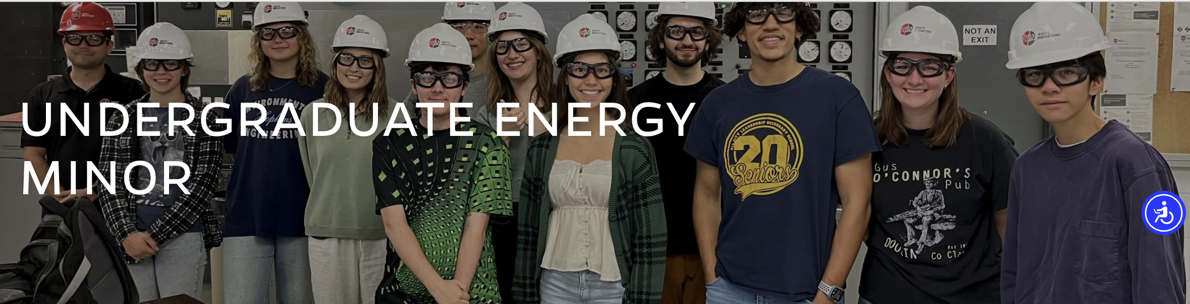
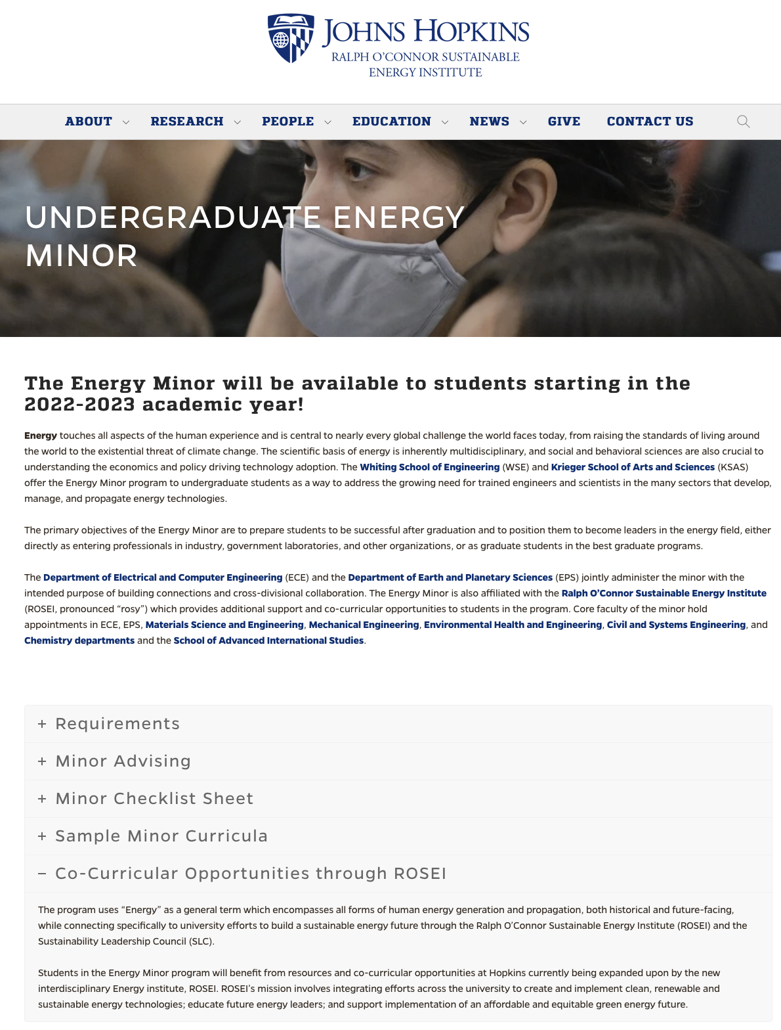
https://energyinstitute.jhu.edu/energy-minor/

Slide 19
Basic Logistics of the Minor
Administration: The energy field is inherently multidisciplinary, motivating a joint WSE/KSAS program:
  KSAS Home: Earth & Planetary Sciences; DUS: Jerry Burgess (jerry.burgess@jhu.edu)
  WSE Home: Electrical & Computer Engineering; DUS: Susanna Thon (susanna.thon@jhu.edu)
  Standing Oversight Committee (you can also go to these folks for advice!):
    Initial composition: Susanna Thon, Jerry Burgess, Ben Hobbs, Scot Miller, Ben Schafer, Darryn Waugh
  ROSEI will provide administrative and co-curricular support
  WEBSITE: https://energyinstitute.jhu.edu/energy-minor/

Slide 20

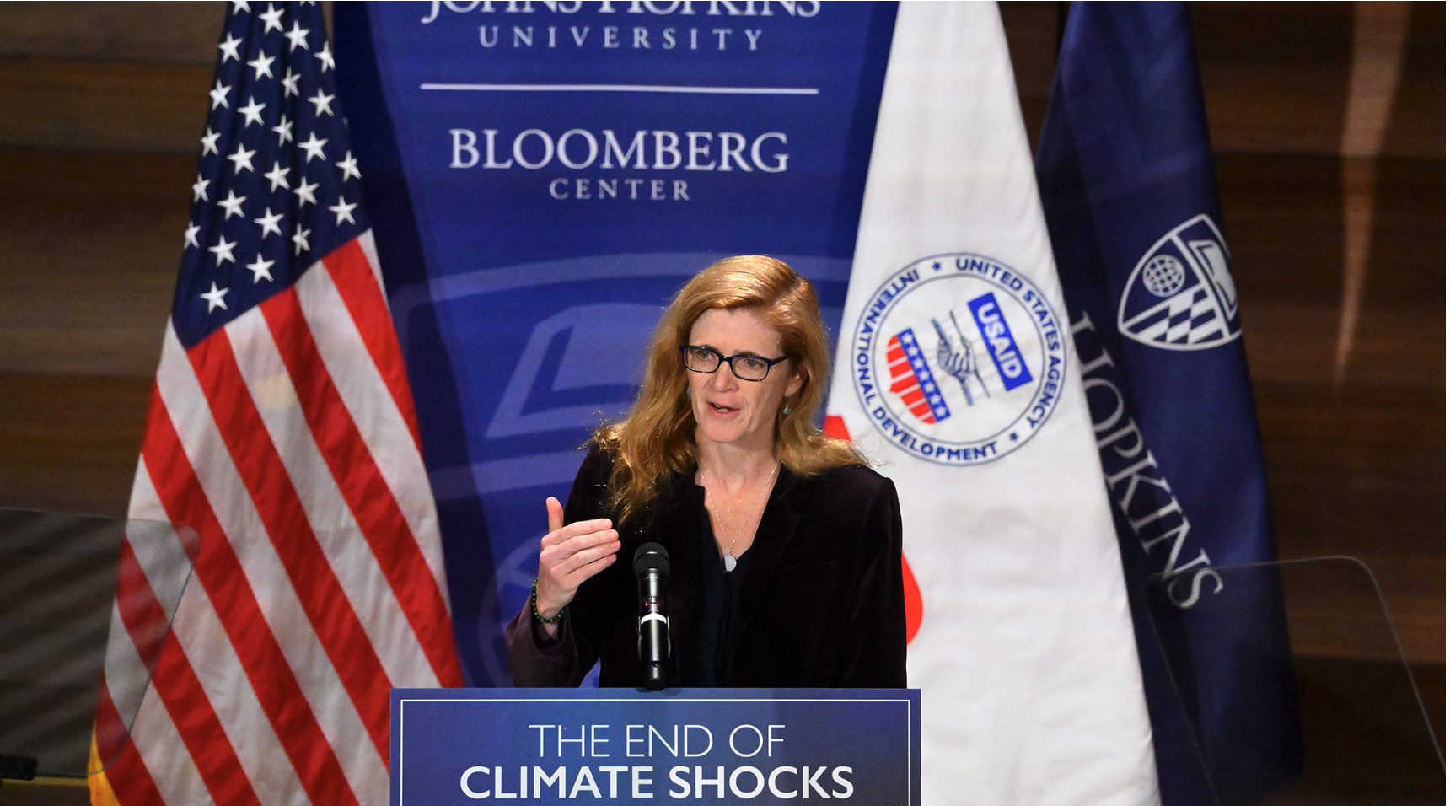
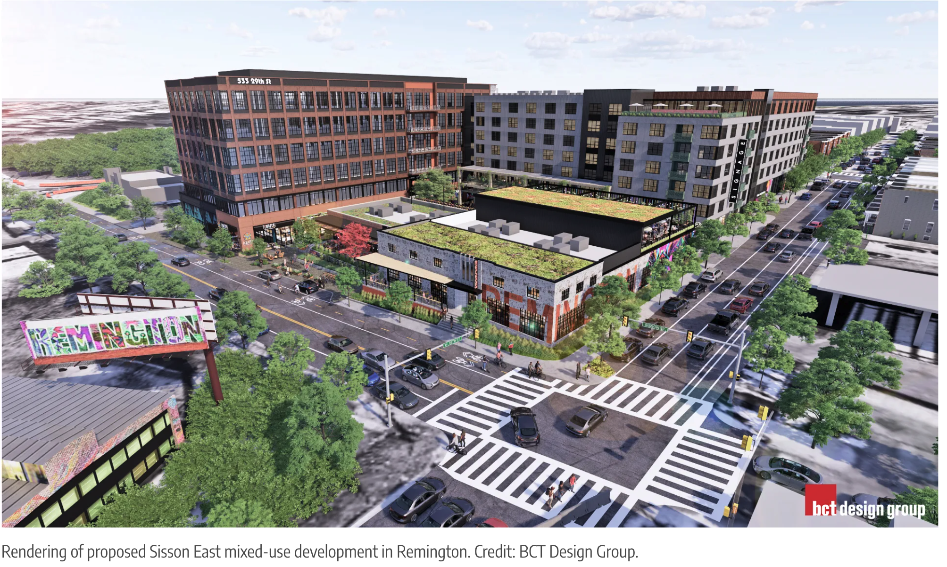
ROSEI Grows with WSE-JHU Evolution (‘23-’25)
Data Science and AI
Government & Policy
Hosted a NEXUS award conference at 555 Penn in January
Had senior leader from ARPA-E to 555 Penn
Data Science and AI BDP Cluster Proposal in process
Grid pillar faculty engaged in AI/ML solutions
New R.Labs will have significantly increased AI/ML hardware capabilities
Remington Energy Hub
Commencing R.Labs build-out in Summer ‘24.
Applied for funding from State of Maryland to assist
Excited about potential to establish Remington as marquee Baltimore EnergyTech hub

Slide 21
Detail on ARROW
& EPICS Centers

Slide 22
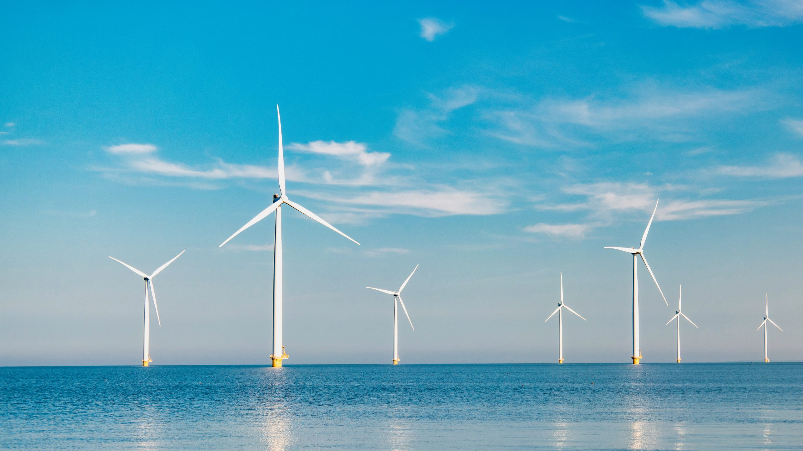





Prof. Sanjay Arwade
ARROW Director
Selected and under contracting negotiation - 25 February 2024 update
Empower, Engage, Innovate
Maryland
Energy
Administration

Slide 23
Theme: Reliability and Resilience
Period of Performance: 5 years from summer ’24
Total budget $11.7M
DOE $4.75M
MassCEC $4.75M
Maryland Energy Administration $1M
University Cost Share $1.2M
Outcomes: An enduring and high impact US academic and training hub for professional OSW workforce development; A system-level embrace of reliability and resilience for the US OSW system with full understanding of uncertainty; Just deployment of the OSW system for the US.
Educate/train/prepare >1000 students BS/MS/PhD/non-degree
Engage stakeholders and communities on ocean/coastal co-use, Energy Equity and Energy Justice
Advance knowledge from atmosphere to grid with targeted research and innovation; targeting uncertainty reductions of 15%

Slide 24
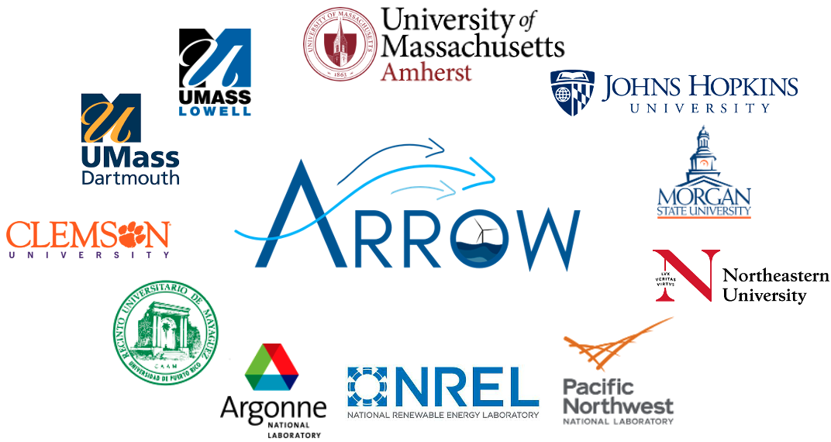
Core Partners
Initial Engagement Partners
ARROW-ENGAGE
The following organizations have already formally agreed to serve on the ARROW External Advisory Board and participate in ARROW’s efforts:
Associations: Oceantic, Electric Power Research Institute, American Iron and Steel Institute, Northeastern Regional Association of Coastal Ocean Observing Systems (NERACOOS);
Consulting: WSP USA, Lautec, NGI, Triton Engineering, Wood Thilstead;
Controls: Arctura, Bachman Electronic Corp.;
Government: Massachusetts Clean Energy Center, Maryland Energy Administration;
Grid/ISO: ISO-New England, Energy Systems Integration Group, Electric Power Research Institute;
Insurance: GuyCarpenter, SwissRe;
Manufacturing: TPI Composites Inc., Keystone Tower Systems;
Materials: Olin Corporation;
NGO’s: Environmental League of MA, Responsible Offshore Science Alliance, Nature Conservancy;
OEM’s: General Electric Renewable Energy, Siemens, Vestas;
Owner-operators: Avangrid, EDF Renewables, Shell International, Invenergy
Initial Affiliate Universities
Pennsylvania State Univ.; Portland State Univ.; Stony Brook Univ.; SUNY Polytechnic; Texas A&M; Univ. of California Davis; Technical Univ. of Denmark (DTU); ForWind Center for Wind Energy Research - Universities of Oldenburg, Hannover and Bremen

Slide 25
Initiatives

Slide 26


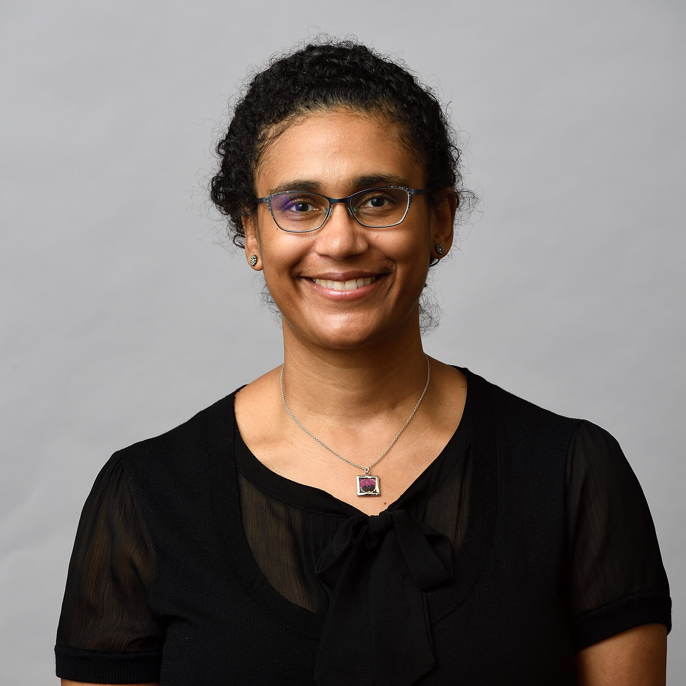
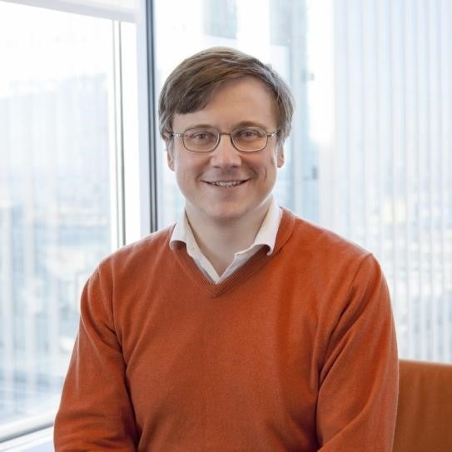
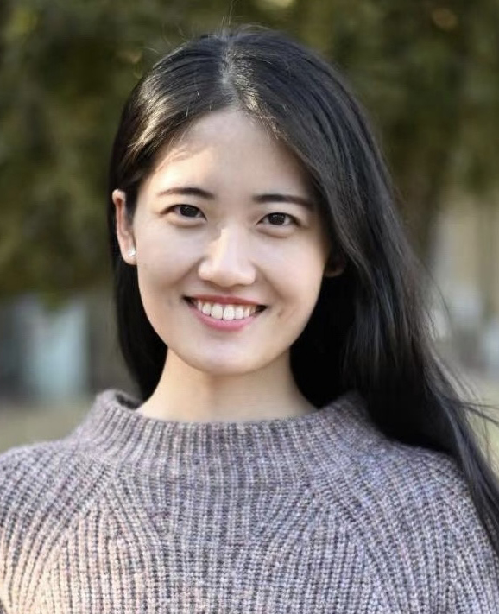
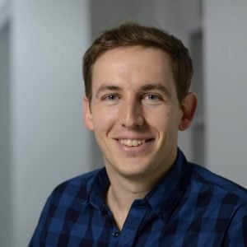
ROSEI – Grid Team
Prof. Ben
Hobbs
Prof. Dennice Gayme
Prof. Yury Dvorkin
Prof. Sijia
Geng
Prof. Enrique
Mallada
A broad range of research capabilities:
  Engineering & Science
  Computer science/Operations research
  Economics and Policy

Slide 27
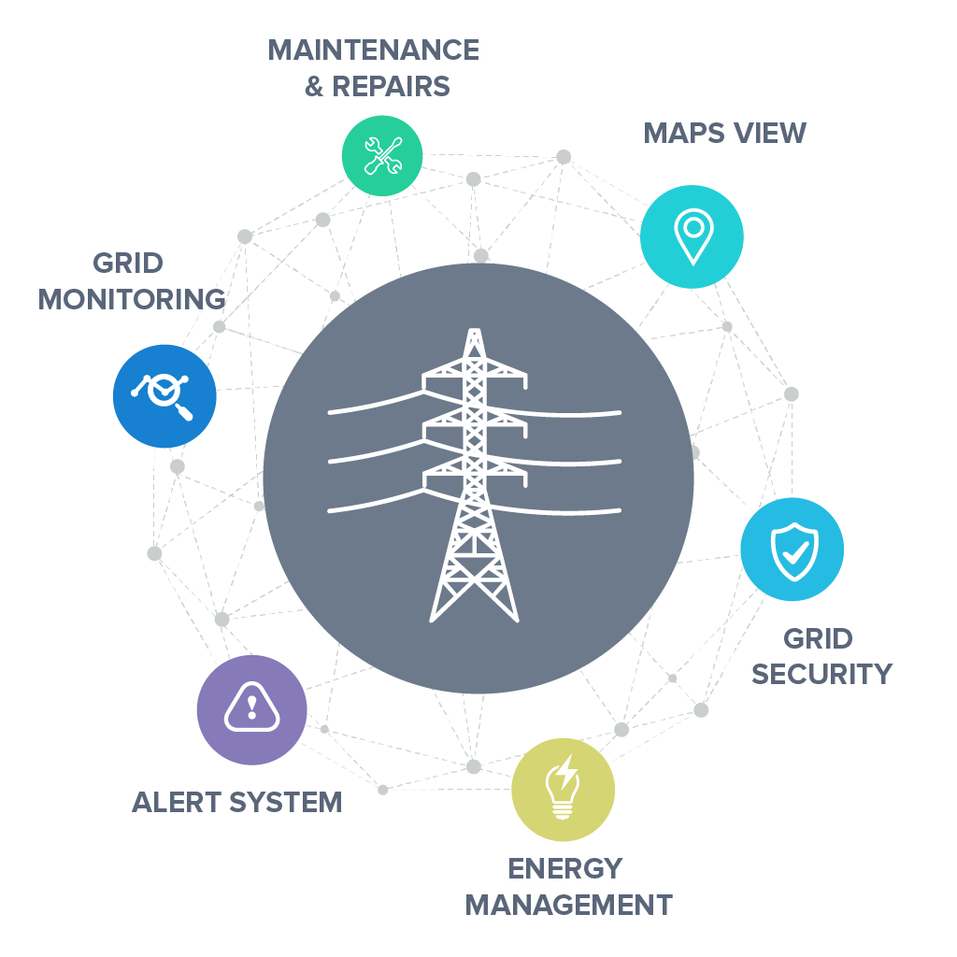
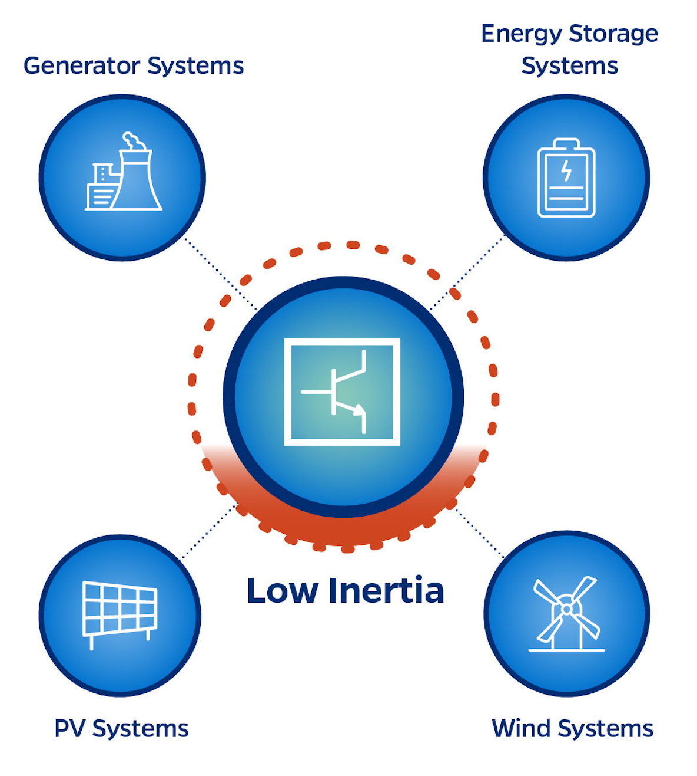
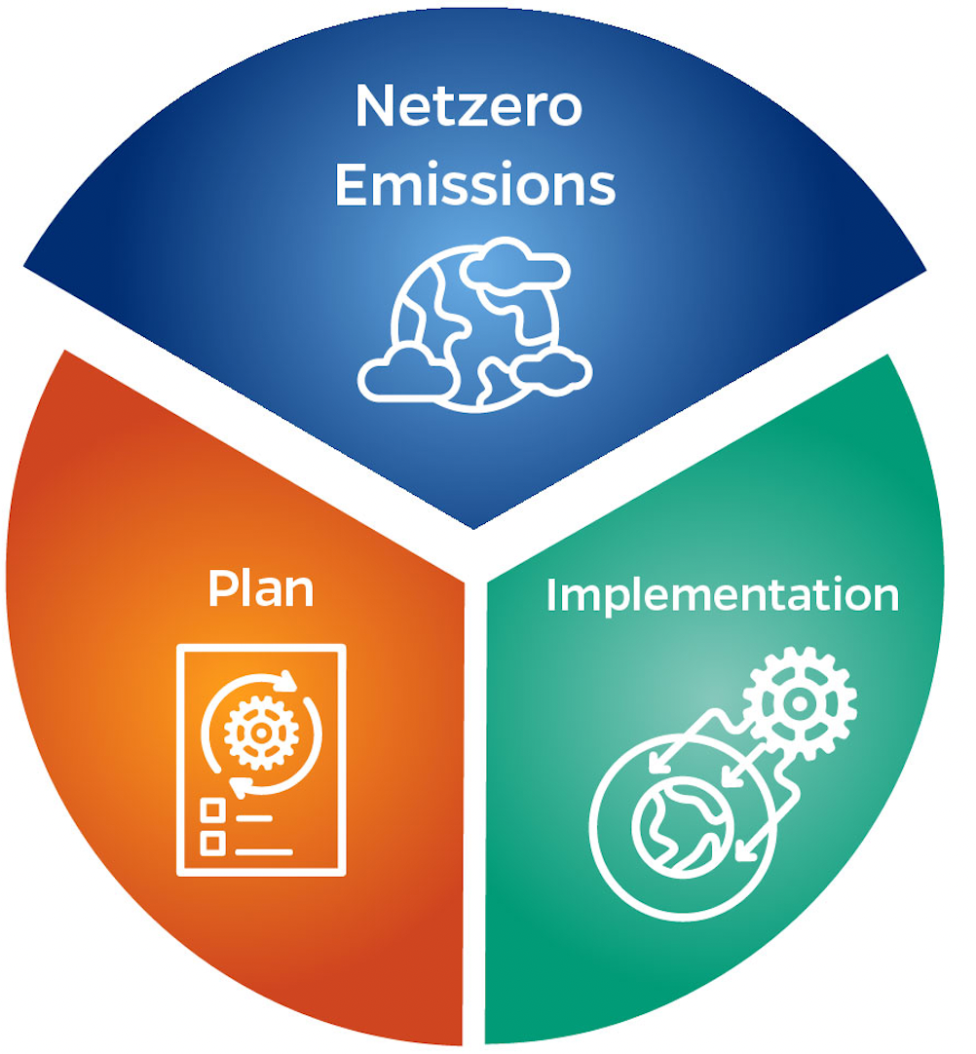




EPICS @ Hopkins
Data and ML for Grid
Low-inertia Grids
Future Electricity Market Design
Net Zero Transition
Strategic Global Partners (200+ engaged industry leaders)

Slide 28

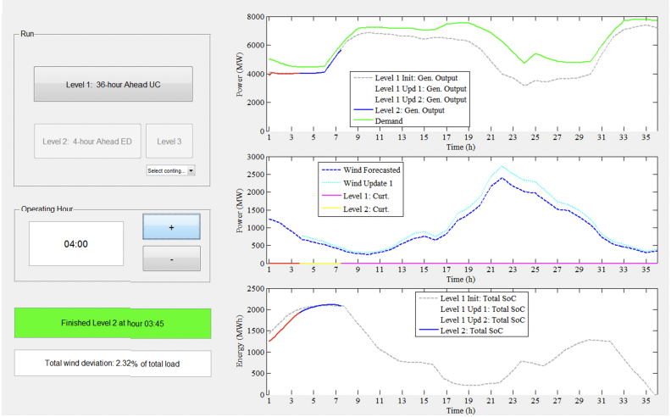

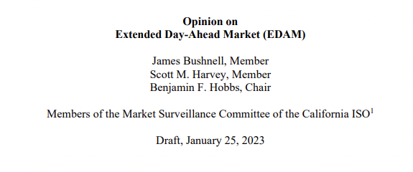



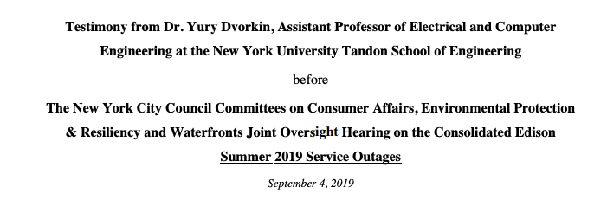
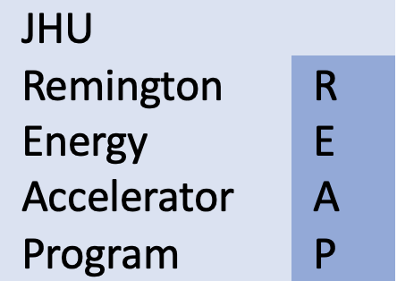
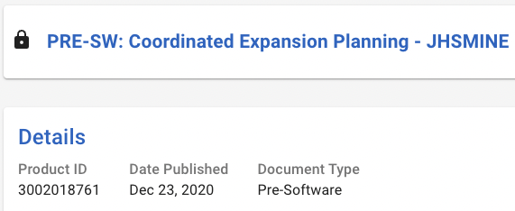

ROSEI and EPICS: Examples of Real-World Impacts
Policy
Technology
Partnerships for Innovation

Slide 29
THANK YOU!

