Slide 1

Strategic Action Plan: Overview
Prepared By
Joe DeLosa III
Johannes Pfeifenberger
Kailin Graham
Prepared For
Northeast States Collaborative on Interregional Transmission
April 29, 2025

Slide 2
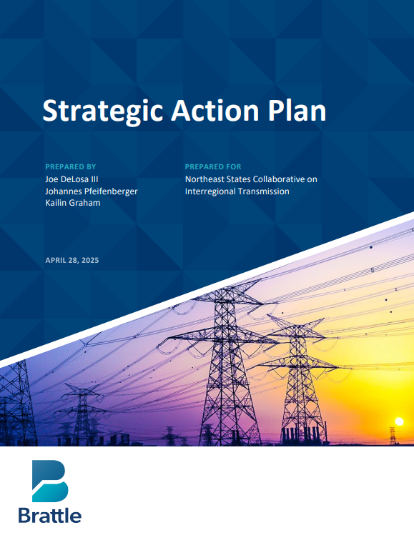

Contents
Strategic Action Plan: Overview
  Current Gaps in Interregional Transmission Initiatives
Addressing Current Gaps in Interregional Planning
Near-Term Action Plan
Mid-Term Action Plan
Strategic Action Plan link

Slide 3
Strategic Action Plan: Overview
The Action Plan is intended to advance the Collaborative’s work by focusing efforts over the near-term (5 in the next year) and mid-term (3 in the next several years)
Near-Term Action Plan
Mid-Term Action Plan
Address Current Gaps in Interregional Transmission:
    Candidate Project Identification (incl. RFI)
    Allocation of Project Costs
  Support Development of Uniform HVDC Design Standards with DOE Consortia
Assess Opportunities to Align and Optimize State Offshore Wind and Transmission Procurements
Develop Interregional Coordination Principles for Order 1920 Compliance Filings
Support Reducing Seams-Related Inefficiencies
  Explore Need for Tariff Revisions Based on Lessons Learned
  Explore the Creation of a Buying Pool for Transmission Equipment
  Enable the Transition From Generator Export Lines to Network Transmission Facilities

Slide 4
Current Gaps in Interregional Transmission Initiatives
Interregional transmission between NY, NE, and PJM is highly valuable in the near- and long-term, and low-regrets expansion opportunities should be pursued
  Cost-effective expansions between these regions are identified in numerous studies by DOE, NERC, national labs, MIT, states, and industry
  Based on these studies, we identify a 2035 low-regrets need of 2 GW between NY and PJM and 1.7 GW between New York and New England
    While uncertain, studies expect the magnitude of low-regrets expansions to increase, even without decarbonization drivers
  Studies also highlighted the long-term need for expansion between the Northeast and Canada
    By 2050: 10 GW between Canada and Northeast is low-regrets
  Realizing the value of interregional transmission identified in these studies requires overcoming key barriers, particularly introducing intertie optimization and fully accounting for the value of existing and new interties
    The exact magnitude of interregional transfer capability needs remain uncertain and depends on progress on decarbonization as well as load growth
Estimated Range of Low-Regrets Transmission Expansion Needs (GW)
New York–PJM
New York–New England
High-decarb., high-load
High-decarb., moderate-load
Non-decarb. drivers

Slide 5
Near-Term Action Plan: A. Addressing Current Gaps
The Action Plan sets out near-term steps necessary to identify, evaluate, select, and provide the opportunity for states to agree to share the cost of beneficial interregional transmission projects so they can be developed.
Interregional Candidate Project Identification
  In light of the lack of ISO-led processes for identifying beneficial interregional transmission, the Collaborative should develop and issue a Request for Information on project designs that could meet low-regrets needs
  Scope of the Request focused on “low-hanging fruit” opportunities to identify the most cost-effective projects with near-term benefits and feasible implementation plans, including grid enhancing technologies
    RTOs will need to be critical technical advisors and participants in the effort, given the ultimate need to integrate any identified transmission project with the RTO/ISO regional plans, and the roles of existing transmission coordination venues
Interregional Allocation of Project Costs
  For any interregional transmission project to be pursued, states will need to agree on a framework for identifying benefits and sharing the resulting costs of investments
  A successful cost allocation framework will need to be:
    Sufficiently flexible to accommodate projects that address a variety of regional needs (e.g., reliability, economic, and policy)
    Specific enough to be implementable by RTO/ISOs, without being overly restrictive or formulaic
  We recommend developing a strawman approach, including an invitation for comments on cost allocation structures and benefit methods, referencing existing best practices, Commission precedent, and other innovative approaches

Slide 6
Near-Term Action Plan
B. Support Development of Uniform HVDC Design Standards with DOE Consortia
C. Assess Opportunities to Align and Optimize State Offshore Wind and Transmission Procurements
D. Develop Interregional Coordination Principles for Order 1920 Compliance Filings
E. Support Reducing Seams-Related Inefficiencies
Challenge:
  MSSC caps do not permit delivery of 2,000 MW from OSW based on latest 525kV bi-pole HVDC technology
Action Items:
  POINTS Consortium
  Develop recommendations for technology standardization
  Engage industry to ensure recommendations are feasible for design and construction
  Enable states to agree on a common network-ready HVDC standard, to enable large HVDC facilities can be networked to provide expanded regional or interregional capabilities
Challenge:
  States are subject to different requirements that result in customized procurement frameworks
Action Items:
  Specify and provide the ability for states to coordinate and adopt a set of best practices, including by potentially:
  Incorporating “network-ready” standard for export cables
  Creating the option to convert export cables into open access facilities
  Developing bid evaluation criteria to reflect transmission value
  Combining state procurements into multi-state efforts
  Preserving contracting flexibility to avoid supply-chain bottlenecks
Challenge:
  Limited focus paid by RTO/ISO to the updated requirements of Order 1920 regarding interregional coordination
Action Items:
  Develop a set of interregional planning principles
  Current timing restrictions should be eliminated
  Should specify that all benefits to each region should be considered
  Coordinate with regions to incorporate Collaborative principles within Order 1920 coordination provisions
Challenge:
  Existing interregional transmission facilities are poorly utilized
  RTO/ISOs do not recognize value interregional transmission provides within planning analyses
Action Items:
  Resolve seam-related inefficiencies, including by advocating for intertie optimization
  Encourage regions to assess and consider the benefits of better-utilized interregional facilities within improved planning processes

Slide 7
Mid-Term Action Plan
A. Explore Need for Tariff Revisions Based on Lessons Learned
B. Explore the Creation of a Buying Pool for Transmission Equipment
C. Enable the Transition from Generator Export Lines to Network Transmission Facilities
Challenge:
  Tariff provisions may not be well-suited to enable joint selection, pursuit, funding, and allocation of projects identified through the RFI.
  Projects identified by the Collaborative may be poorly suited for existing processes, as a project is unlikely to satisfy discrete regional needs in each region’s planning process, which proceed on inconsistent timelines
  These existing processes overlook opportunities for mutually beneficial interregional transmission facilities
Action Items:
  Coordinate with RTO/ISOs to develop the necessary revisions (if any) to their market rules to enable the evaluation and selection of identified beneficial interregional projects, and apply the Collaborative’s desired cost allocation
Challenge:
  Lack of a centralized mechanism for coordinated bulk orders of HVDC equipment
  International competition for HVDC supply chain expansion and timely delivery
Action Items:
  Take initial steps towards determining the preferred structure and necessary scope of such a buying pool.
  Research the following questions:
  What is the minimum buy-in for suppliers to participate?
  What are off-ramps for changes in policy or schedule?
  How much capital would need to be put “at-risk”?
  Which technological criteria must be determined in advance?
  How to account for technological evolution?
Challenge:
  Individual offshore wind generators’ radial export lines may eventually become transmission facilities of a future networked offshore grid
  Current offshore wind procurements do not consistently specify and enable the future transition of export cables to open-access network transmission facilities
Action Items:
  Identify the necessary contractual and regulatory frameworks that could be adapted to create networked offshore grid
  Evaluate mechanisms that have been developed to meet this goal, including CAISO’s Subscriber Participating Transmission Owner model.
  Lead a series of discussion with FERC staff to consult on the application of open-access precedent throughout the process

Slide 8
Additional Slides:
Synthesis of Transmission Needs Studies

Slide 9
New York – PJM: Significant transmission expansion between is valuable in the near-term
Based on multiple independent studies, we estimate that at least 2 GW additional transfer capability between New York and PJM by 2035 is low-regrets, even without considering the value of transmission for decarbonization
  Represents low end of range from all studies, and central value of studies that did not consider decarbonization as the driver for transmission development
At least 4 GW by 2040 is likely low-regrets, but needs may be significantly higher in high-decarbonization futures (up to 12–15 GW)
  Building in flexibility and expandability is likely efficient given the potential for
  much larger long-term needs
  Our low-regrets estimates for high-decarb. futures range from 4.5–6 GW in 2040 to 6–8 GW in 2050
    Datacenter and electrification demand in PJM makes high-load scenarios more likely
Estimated Range of NY–PJM Transmission Needs (GW)
Non-decarb. drivers
High-decarb., moderate-load
High-decarb., high-load
Brattle estimate of low-regrets expansion
Brattle estimate of low-regrets expansion
Brattle estimate of low-regrets expansion
NTPS, DemHi, HVDC,
90% by 2035
NTPS,
DemMd,
HVDC,
90% by 2035
TNS Mod/ High (2040)
TNS High/ High (2040)
TNS Mod/High (2040)
NTPS, DemMd, current policies
TNS High/ High (2035)
NTPS, DemHi, current policies
NTPS, DemMd, current policies
MA Decarb, no new gas
Range in GE-NRDC study
TNS Mod/ High (2035)
MA Decarb, limited efficiency
NTPS, DemHi, 90% by 2035
NREL IREZ
NTPS,
HVDC, “high-opportunity”
NERC
NTPS, DemMd, current policies
NTPS, DemMd, 90% by 2035
NTPS, DemMd, 90% by 2035
TNS Mod/Mod (2035)
TNS Mod/ Mod (2040)
Notes: Ranges above cover transfer capability needs reported in the DOE 2023 Transmission Needs study (TNS, summarizing multiple studies), DOE National Transmission Planning Study (NTPS), GE-NRDC study, MA Decarbonization Pathways study, LBNL study, NREL IREZ study, and NERC ITCS study. These ranges exclude scenarios deemed unrealistic, such scenarios with zero transmission expansion between NY and PJM in the MA Decarb Study. Annotations indicate noteworthy scenarios from these studies. NTPS results are from “AC” expansion scenarios unless denoted otherwise.

Slide 10
New York – New England: Interregional upgrades across the interface presents low-regrets, near-term opportunities
Based on multiple independent studies, we estimate that at least 1.7 GW additional transfer capability between NY and New England by 2035 is low-regrets, even without considering the value of transmission for decarbonization.
  Similarly represents low end of range across studies and central estimate of studies that did not consider decarbonization as the driver for transmission development
Long-term (2040–2050) needs are highly uncertain; depend on scale and location of renewables adoption as well as load growth
  3 GW by 2040 is low-regrets, but may be conservative given decarbonization
  ambitions of both regions
    Our low-regrets estimates for high-decarbonization scenarios conservatively
    skew towards the bottom of each range
    given the uncertainty amongst projects
  Option value for increased transfer capability is particularly valuable, given potentially high interregional needs
Estimated Range of New England–NY Transmission Needs (GW)
Non-decarb. drivers
High-decarb., moderate-load
High-decarb., high-load
Brattle estimate of low-regrets expansion
Brattle estimate of low-regrets expansion
Brattle estimate of low-regrets expansion
TNS
High/
High
(2040)
NTPS DemHi, current policies
TNS, High/ High (2035)
NTPS, DemMd, current policies
NTPS, DemMd, current policies
TNS Mod/ High (2040)
NTPS, DemLo, HVDC, current policies
NTPS, DemHi,
HVDC, 90% by 2035
NTPS, DemHi, 90% by 2035
NTPS, DemLo, HVDC,
current policies
NTPS, DemMd, HVDC, 90% by 2035
TNS Mod/Mod (2035, 2040);
NREL IREZ;
NTPS, DemLo, current policies (2040)
TNS Mod/ High (2035)
NTPS, DemLo, current policies
MA Decarb:
coord. (low Tx cost)
NTPS, DemHi, 90% by 2035
MA Decarb, no new gas
NTPS, DemMd, 90% by 2035
GE-NRDC
NTPS, “high-opportunity” (2035)
NTPS, DemLo, 90% by 2035
MA Decarb, baseline
NTPS, DemLo, current policies
100% VRE
Notes: “Non-decarb. drivers” refers to scenarios where decarbonization was not a driver/constraint for the analysis. Ranges above cover transfer capability needs reported in the DOE 2023 Transmission Needs study (TNS, summarizing multiple studies), DOE National Transmission Planning Study (NTPS), GE-NRDC study, MA Decarbonization Pathways study, and NREL IREZ study. These ranges exclude scenarios deemed unrealistic, such as low-electrification and low-offshore wind scenarios in the MA Decarb. study which report low transmission needs due to new nuclear capacity in NY and CT. Annotations indicate noteworthy scenarios from these studies. NTPS results are from “AC” expansion scenarios unless denoted otherwise.

Slide 11
Canada: Significant expansion between the Northeast and Quebec is valuable long-term, and near-term for reliability in New York
Based on multiple independent studies, we estimate that at least 5 GW additional transfer capability by 2050 between both New England and Quebec and New York and Quebec is low-regrets. When just considering reliability benefits, 1.9 GW between New York and Quebec by 2033 is low-regrets
  While fewer studies considered transmission expansion to Canada, long-term (2050) studies show consistent value in significant expansion between Quebec and both New England and New York
    Needs are greater (up to 7 GW) in higher renewables/low thermal generation futures
    Value is derived from operating lines bidirectionally to balance Northeast renewables
  The MA Decarbonization Pathways study found a moderate need between New England–New Brunswick between 0–0.8 GW by 2050, scaling to 2.7 GW in a future with no new gas generation
NERC study demonstrates near-term reliability need
  0.4 GW between NE–QC, 1.9 GW between NY–QC,
  0.3 GW between NE–Maritimes
  These figures consider resource adequacy only, and are therefore conservative estimates that do not consider economic or public policy benefits of further expansion
Estimated Range of Northeast–Canada Transmission Needs (GW)
New England–Quebec
New York–Quebec
New England–Maritimes
MA Decarb.:
no new gas
MA Decarb.:
no new gas, limited eff.
limited efficiency
low electrification
low electrification
baseline
baseline
MIT CEEPR
MIT CEEPR
MA Decarb.: no new gas
NERC ITCS (reliability only)
NERC ITCS (reliability only)
NERC ITCS (reliability only)
baseline, low elec.
Notes: Ranges above cover transfer capability needs reported in the NERC ITCS (2033 only), the MIT CEEPR study (2050 only) and the MA Decarbonization Pathways study (2050 only). Annotations indicate noteworthy scenarios from these studies.

Slide 12
List of Studies Reviewed
Study | Years analyzed | Findings
1. DOE 2023 Transmission Needs Study | 2030, 2035, 2040 | NY-New England: 2035: 2.8–17 GW; 2040: 2.9–21.4 GW NY-PJM: 2035: 0.29–8.24 GW; 2040: 0.81–12.7 GW
2. DOE National Transmission Planning Study | 2035, 2040, 2050 | NY-New England: 1.7–2.9 GW by 2035, 3.8–6.7 GW by 2040 in central case NY-PJM: ~1 GW by 2040 for AC, but much higher in HVDC futures
3. DOE Atlantic OSW Transmission Study | 2050 | Interregional topology resulted in a total of 14 GW of offshore transmission between Atlantic states, with a benefit-cost ratio of 2.9 ($2.4 billion/yr in production cost and resource adequacy benefits) [granular results on transfer capability needs between individual regions not provided].
4. GE-NRDC Study | 2035 | $12 billion in net present value from 87 GW interregional transmission (2 GW between NY-NE, 5 GW between NY-PJM), including $1 billion in resilience benefits from single 2035 polar vortex event.
5. MA Decarb Pathways Study | 2050 | NY-New England: 0.5–4.5 GW (1.6–4.5 GW when focusing on most realistic scenarios) NY-PJM: 1.5–7 GW (Caveat: PJM was not explicitly modeled as its own zone but a boundary condition for New York) QC-NY: 3.8–6.8 GW QC-New England: 4.1–7.1 GW New England-Maritimes: 0–2.7 GW (0–0.8 GW when focusing on most realistic scenarios)
Study | Years analyzed | Findings
6. LBNL Analyses | 2012–2023 | NY-New England: documents historical energy market value of $137–189 million/yr per GW of transmission NY-PJM: documents historical energy market value of $149–156 million/yr per GW of transmission
7. NREL IREZ | 2022 | 3 GW expansions from PJM to New York and New York to New England increases energy cost savings of transmission corridor by $118 million/yr and $28 million/yr, respectively (incremental costs: $27 million/yr and $21 million/yr, respectively)
8. MIT CEEPR | 2050 | QC-New England: 4 GW provides power system cost savings of $1,121 million/yr (13%) QC-NY: 4 GW provides power system cost savings of $913 million/yr (13%) Value is generated by utilizing the transmission bidirectionally to balance Northeast renewables, avoiding firming costs
9. NERC ITCS | 2033 | NY-New England: 0 GW (this is unlikely once considering economic and public policy benefits) NY-PJM: 1.8 GW to alleviate significant resource deficiencies in New York QC-New England: 400 MW QC-NY: 1.9 GW New England-Maritimes: 300 MW
For Study Summaries, see: Strategic Action Plan, Phase 1: Study Synthesis of Transmission Needs (Feb 2025)

Slide 13
Note on Existing Interregional Transfer Capability
  In additional to transmission expansion needs, we found that there were a range of values reported across different studies for how much interregional transfer capability exists today
  Namely, the DOE Transmission Needs Study, DOE National Transmission Planning Study (NTPS), and NERC Interregional Transfer Capability Study report different existing transfer capabilities at the New York–New England and New York–PJM interfaces
  Different assumptions on existing capability partially explain differences in additional transfer capability needs
    e.g. DOE NTPS assumes greater existing transfer capability between New York and PJM than the Transmission Needs Study, and as a result finds less expansion is needed at that interface
 | DOE Transmission Needs Study | DOE NTPS | NERC ITCS
New York <> New England | 2,030 MW | 3,500 MW | Summer: >1,303 / <1,660 MW Winter: >2,432 / <1,359 MW
New York <> PJM | 2,000 MW | 6,600 MW | Summer: >913 / <1,356 MW Winter: >4,019 / <4,814 MW
Sources: DOE NTP Study Team letter, December 17, 2024; NERC ITCS Phase 1 results.

Slide 14
The Need to Address Inefficiencies Across Market Seams

Slide 15
Five Sources of Inefficiencies Created by Market Seams
Seams between RTOs will generally be more efficient than seams between non-market regions that rely entirely on bilateral trades. Nevertheless, significant seams-related inefficiencies exist between RTO markets:
  Interregional transmission planning is ineffective
  Generator interconnection delays and cost uncertainty created by affected system impact studies (and effectiveness coordination through means such as the SPP-MISO JTIQ, reducing costs by 50%)
  Resource adequacy value of interties (often not considered in RTO’s resource adequacy evaluations) and barriers to capacity trades (often created by RTOs’ restrictive capacity import requirements and incompatible resource accreditations)
  Loop flow management inefficiencies through market-to-market coordinated flowgates (with shares of firm flow entitlements) under the existing JOAs
  Inefficient trading across contract-path market seams and the need for intertie optimization

Slide 16

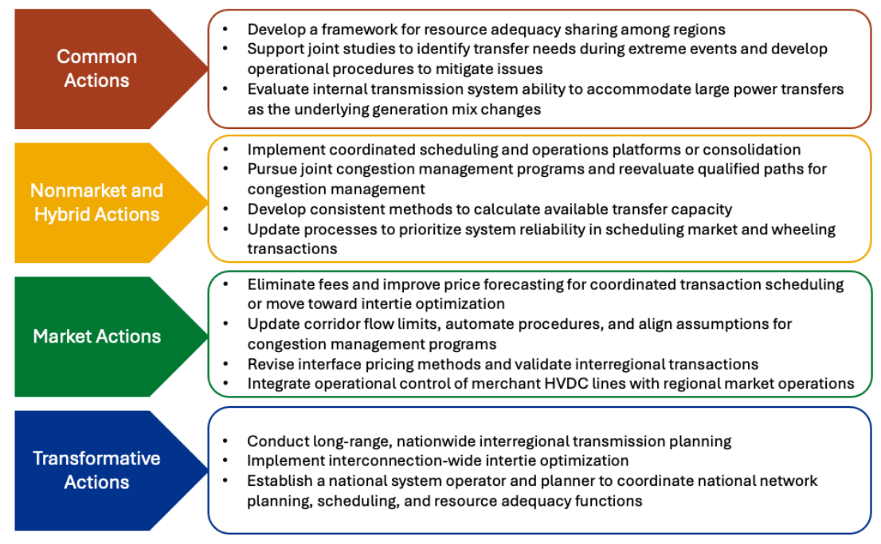
NREL Report: Barriers and Opportunities to Realize the System Value of Interregional Transmission (June 2024)
NREL recommends reforms to “significantly enhance the value of interregional transmission and deliver additional within-region benefits”:
  Recognize resource-adequacy and resilience value of interregional transmission
  Improved coordination and joint congestion management
  De-pancaking
  Improved intertie pricing
  Move toward intertie optimization
  Interregional planning
  Interconnection-wide optimization

Slide 17

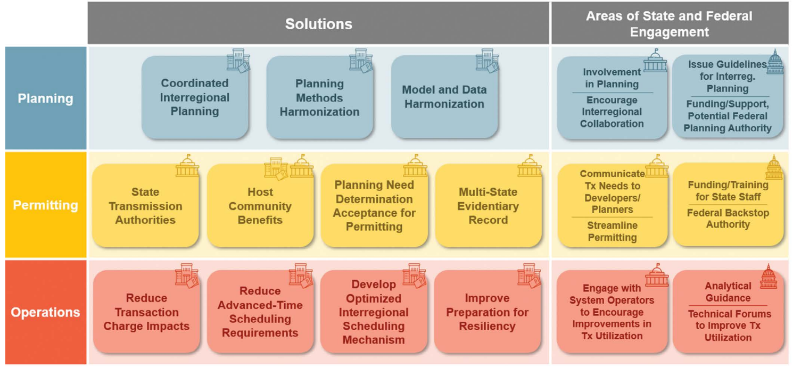

NARUC Report: Collaborative Enhancements to Unlock Interregional Transmission (June 2024)
Recommends reforms improve planning, permitting, and operational utilization of interregional transmission, including intertie optimization:
Source: https://pubs.naruc.org/pub/BACDBB9D-02BF-0090-0109-B51B36B74439

Slide 18
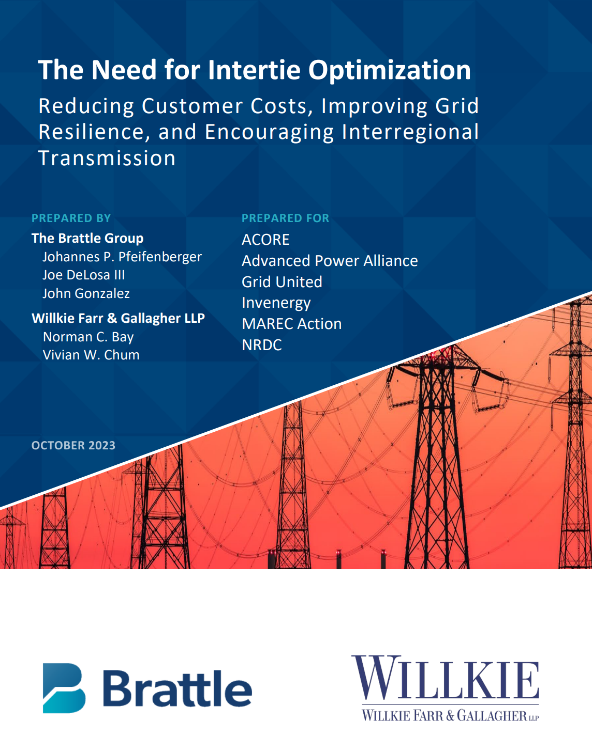
Note
This content is in part based on:
The Need for Intertie Optimization, prepared for ACORE, Advanced Power Alliance, Grid United, Invenergy, MAREC, and NRDC, October 2023
Intertie Optimization FAQs and Implementation Principles, February 2024
Intertie Optimization: Efficient Use of Interregional Transmission (Update), presented to OPSI, April 12, 2024
Market Benefits and Seams: Options and Implications, presented to CREPC-WIRAB, April 24, 2024.
Various State of Market, LBNL, NARUC, and NREL reports (as cited in the slides)

Slide 19
Promising Initiative: SPP’s Inter-Market Optimization Framework
  SPP staff has been exploring an Inter-Market Optimization Framework to improve the efficiency of transfers between SPP and its neighbors, resulting in increased economic benefits for SPP’s market participants
  On October 16, 2024, SPP’s Strategic Planning Committee (SPC) endorsed that staff’s work on this concept be prioritized within the “Optimized Seams” objectives of SPP’s strategic planning roadmap
  SPP’s proposed next steps:
    Further evaluate potential value of adding this feature to the market design
    Prioritize inter-market optimization within the Optimized Seams strategic opportunity
    Develop policy proposals to address challenges identified
Source: SPP Documents & Filings – SPC Meeting Materials, Oct 8, 2024

Slide 20

About the Speaker
Joe DeLosa III is a Manager at The Brattle Group with comprehensive experience at the intersection of state clean energy policy and wholesale electricity markets. He has served as a subject matter expert for clients and senior policymakers across a wide range of power market issues, including cost-effective implementation of state clean energy policy, transmission planning, energy and reserve markets, and resource adequacy. Mr. DeLosa has offered expert guidance on major state policy initiatives, including integrating offshore wind, integrated distribution planning, transmission cost allocation, and retail rate design.
Before joining Brattle, Mr. DeLosa was the Bureau Chief of Federal & Regional Policy at the New Jersey Board of Public Utilities, where he managed all RTO and federal affairs for the State. In his prior role, he also oversaw regulatory affairs for the Delaware Public Service Commission. He has also advised a wide range of PJM states as a long-time member of the Organization of PJM States (OPSI) staff.
Joe DeLosa III
Manager
Washington, D.C.
Joe.DeLosa@brattle.com
+1.845.612.9002
brattle.com | 19

Slide 22











Our Offices
BOSTON
Brussels
Chicago
London
Madrid
New York
Rome
San Francisco
Sydney
Toronto
Washington, DC

