Slide 1

ROSEI General Slides
2025 05 27

Slide 2
JHU and ROSEI Overview

Slide 3
ROSEI Founded in 2021
Vision: Johns Hopkins University is globally recognized for developing technologies, educating people, and supporting policy that equitably addresses the intertwined challenges of climate change and energy use for Baltimore, the nation, and the world.
Mission: The Ralph O’Connor Sustainable Energy Institute (ROSEI) integrates efforts across the university to create and implement clean, renewable and sustainable energy technologies; educate future energy leaders; and within the complex inter-connected systems that energy resides support implementation, markets, and policies that promote an affordable and equitable green energy future for a more resilient world.
Values: Innovation, Education, Equity, Community

Slide 4
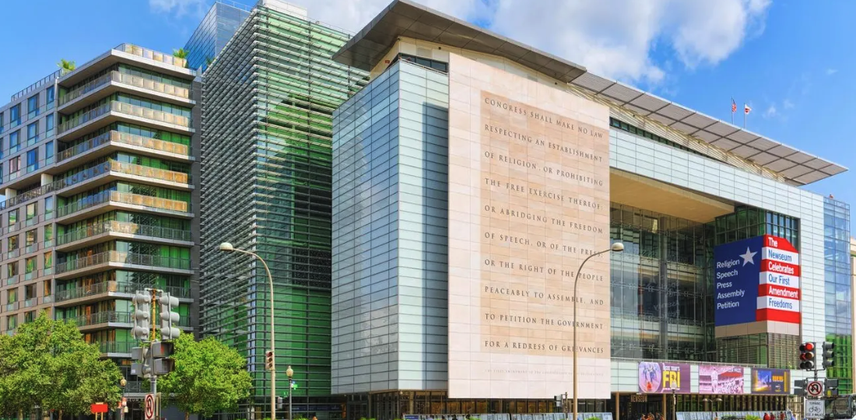

JHU Divisions
COMING SOON:
School of Government and Policy

Slide 5
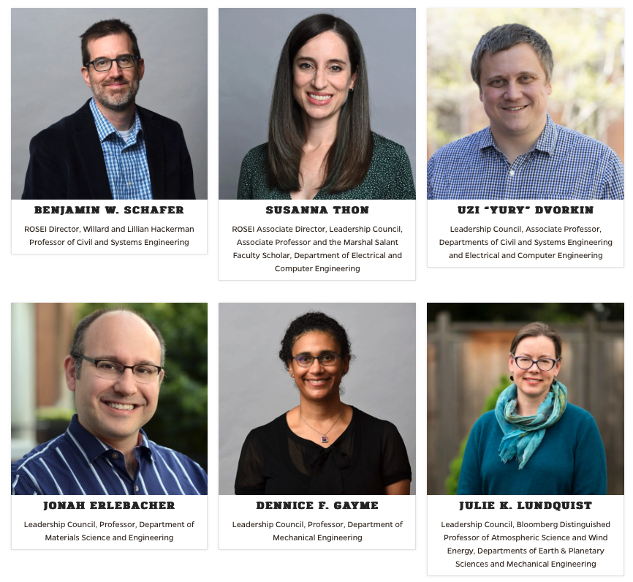
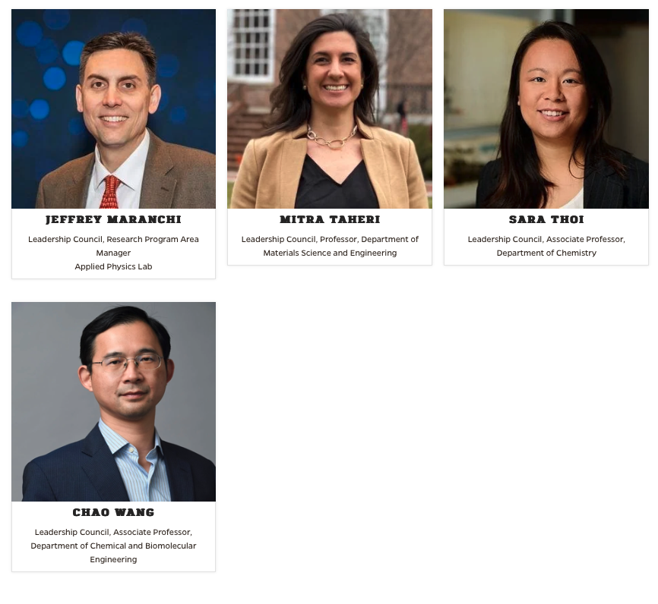
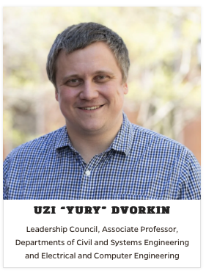
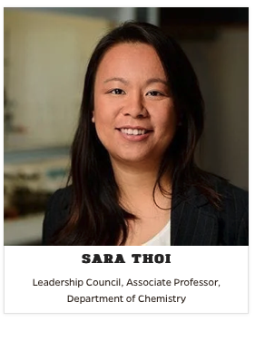
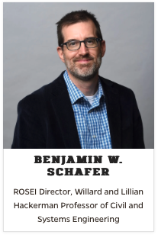
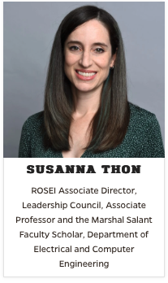
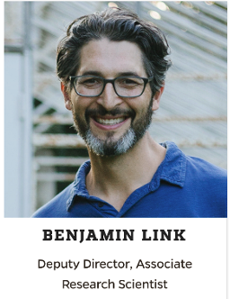
ROSEI Leadership Structure Evolves
Leadership Council
More programming for
Res. Scientists
Postdocs
Graduate Students
Undergraduate Students
Asst. Prof. WG
Research Comm.
Education Comm.
Impact Comm.
Director
Assoc.
Director
Deputy
Director
New working groups (WGs) all can join
Beyond Carbon, Storage, Wind, and Grid verticals.. Adding horizontals
DSAI Initiative
Survey completed
New WGs all can join
Energy Minor
NRT with P. Clancy, REU site
Postdoc and Grad Fellowships
More
New WGs call can join
Policy, Translation, Partnerships
Northeast States Collaborative
Remington Energy Tech Hub
DOE Lab partnerships, GEV, …
More

Slide 6


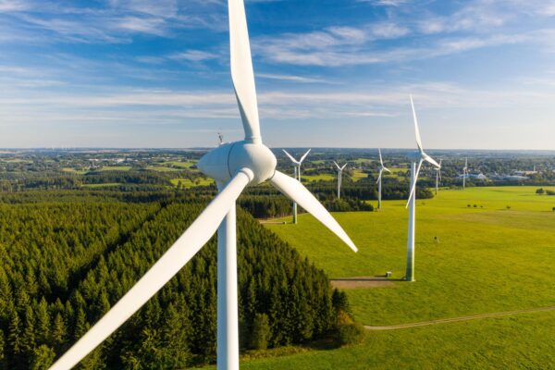
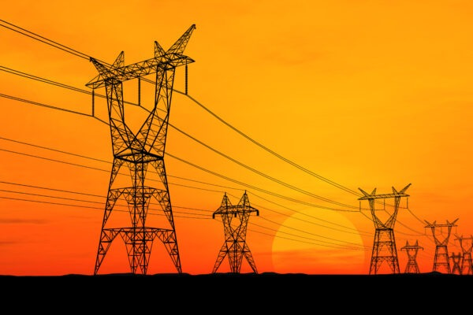
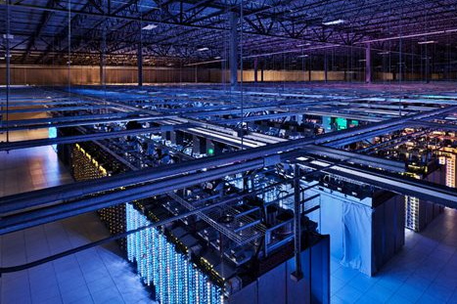
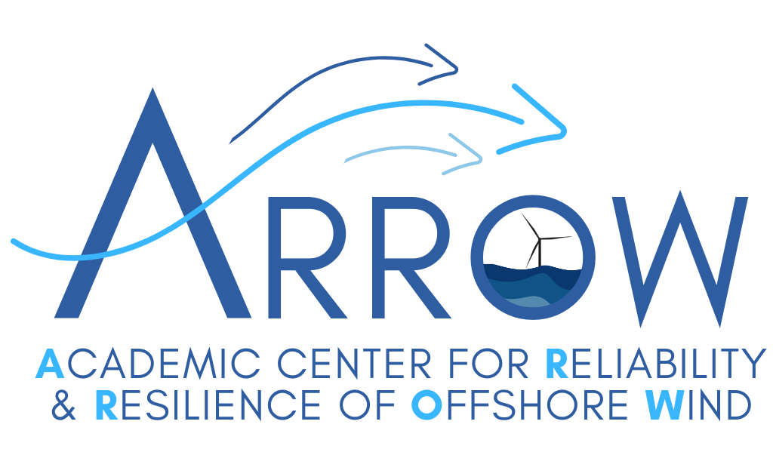





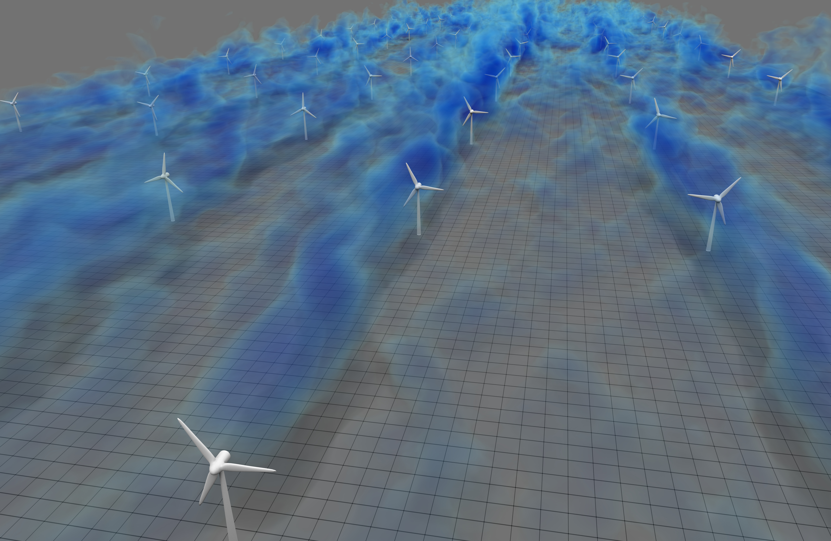
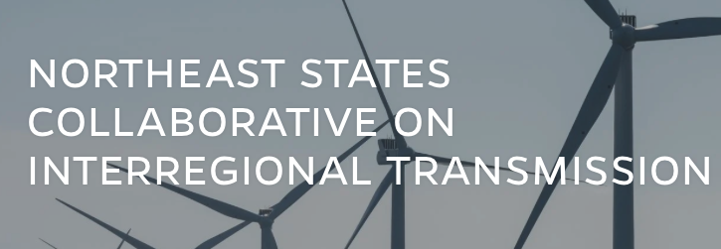

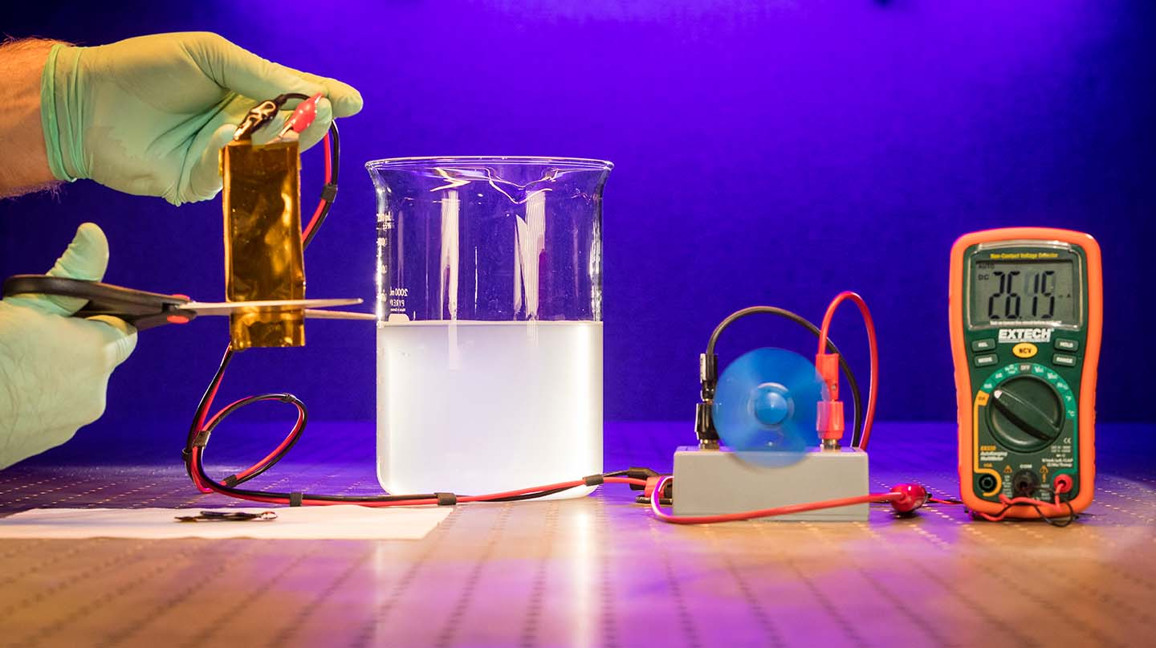





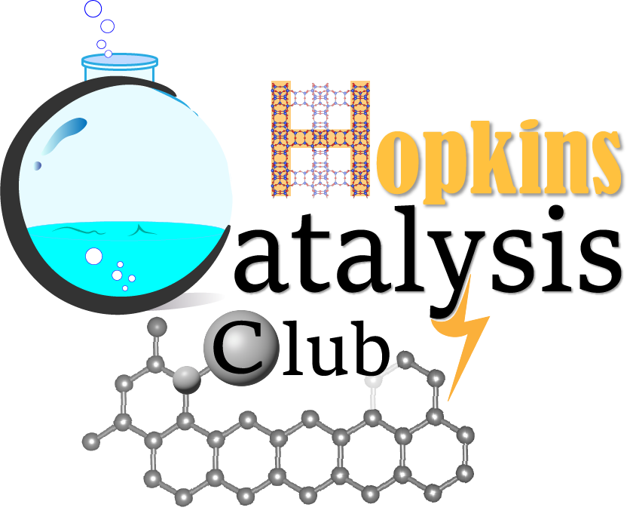








Research
Carbon
Storage
Wind
Grid
& More
Growth and new efforts here in the coming year. Utilizing current strengths, aligning with WSE and university and national initiatives and needs, develop new expertise and partnerships.
Open Science Wind Farm Modeling
Battery cut, and continues operation (APL)

Slide 7
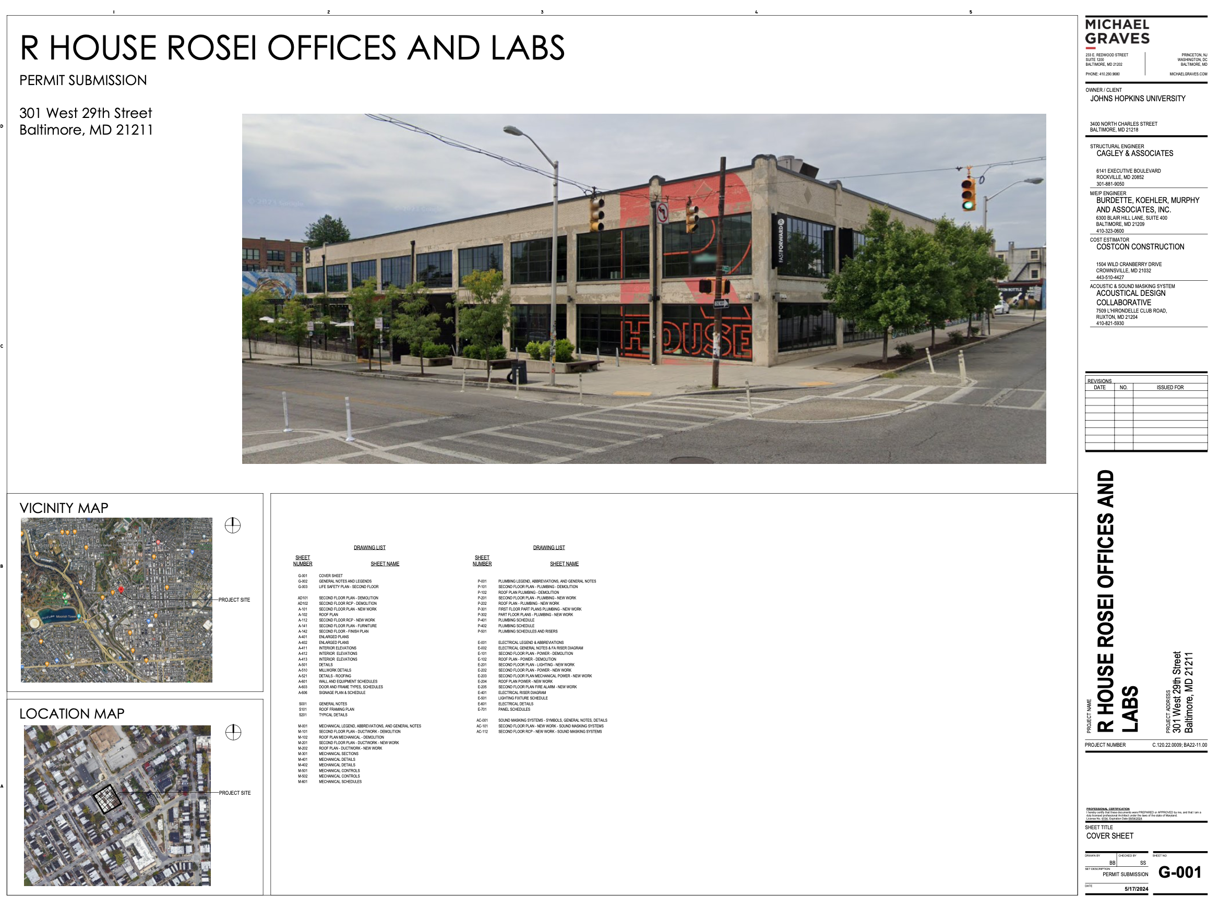

Slide 8
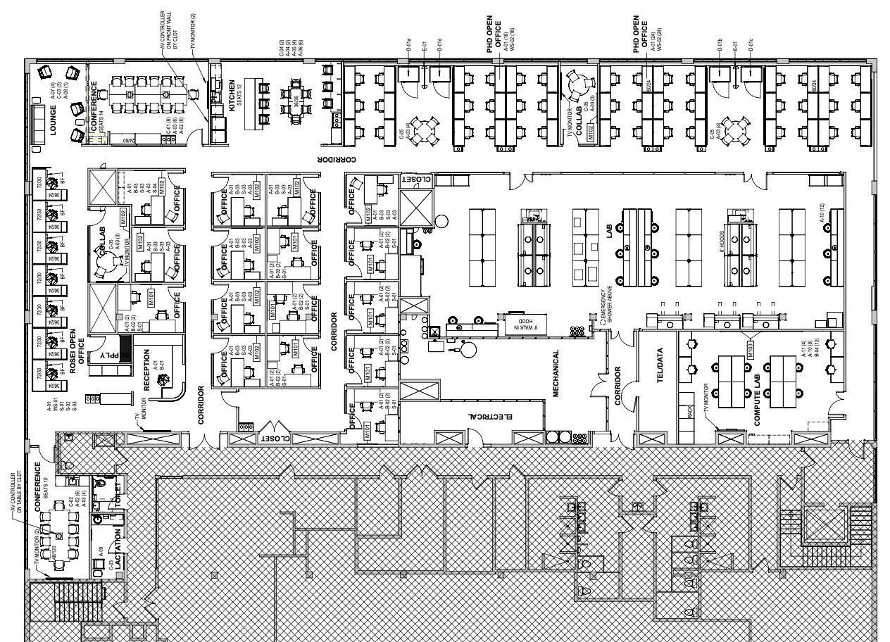
Renovation
Underway!
Estimate Jan.
2026 move in
Fast Forward

Slide 9
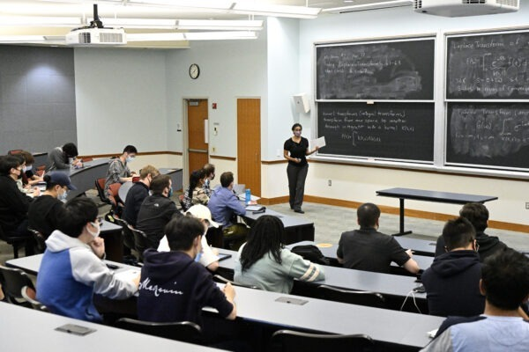
ROSEI Education Efforts: Summary
Pre-College:
  Sustainable Energy Education (SEE)
Undergraduate:
  Energy Minor
  ROSETAS REU Program
Graduate:
  Developing new Master’s program
  PhD Fellowship Program
  NSF NRT: ADAM
Postdoc:
  Postdoctoral Scholars Program

Slide 10
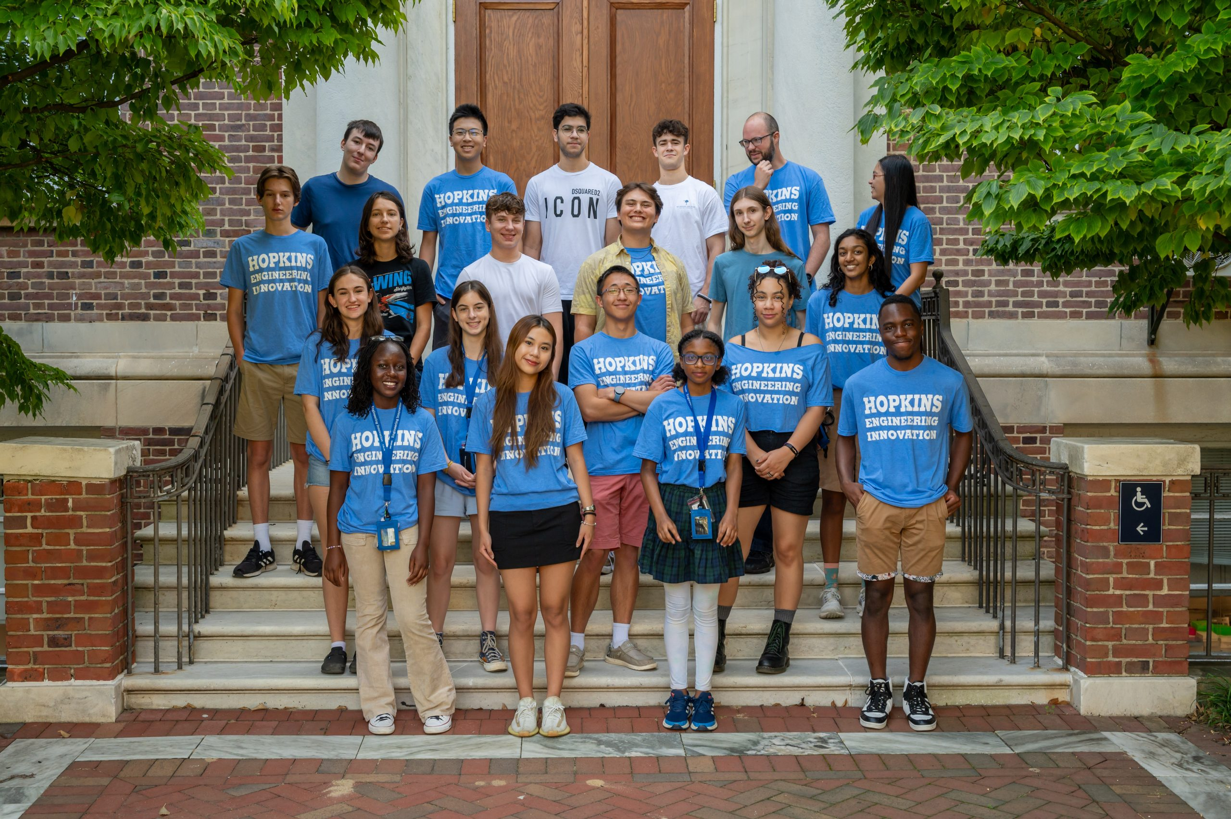
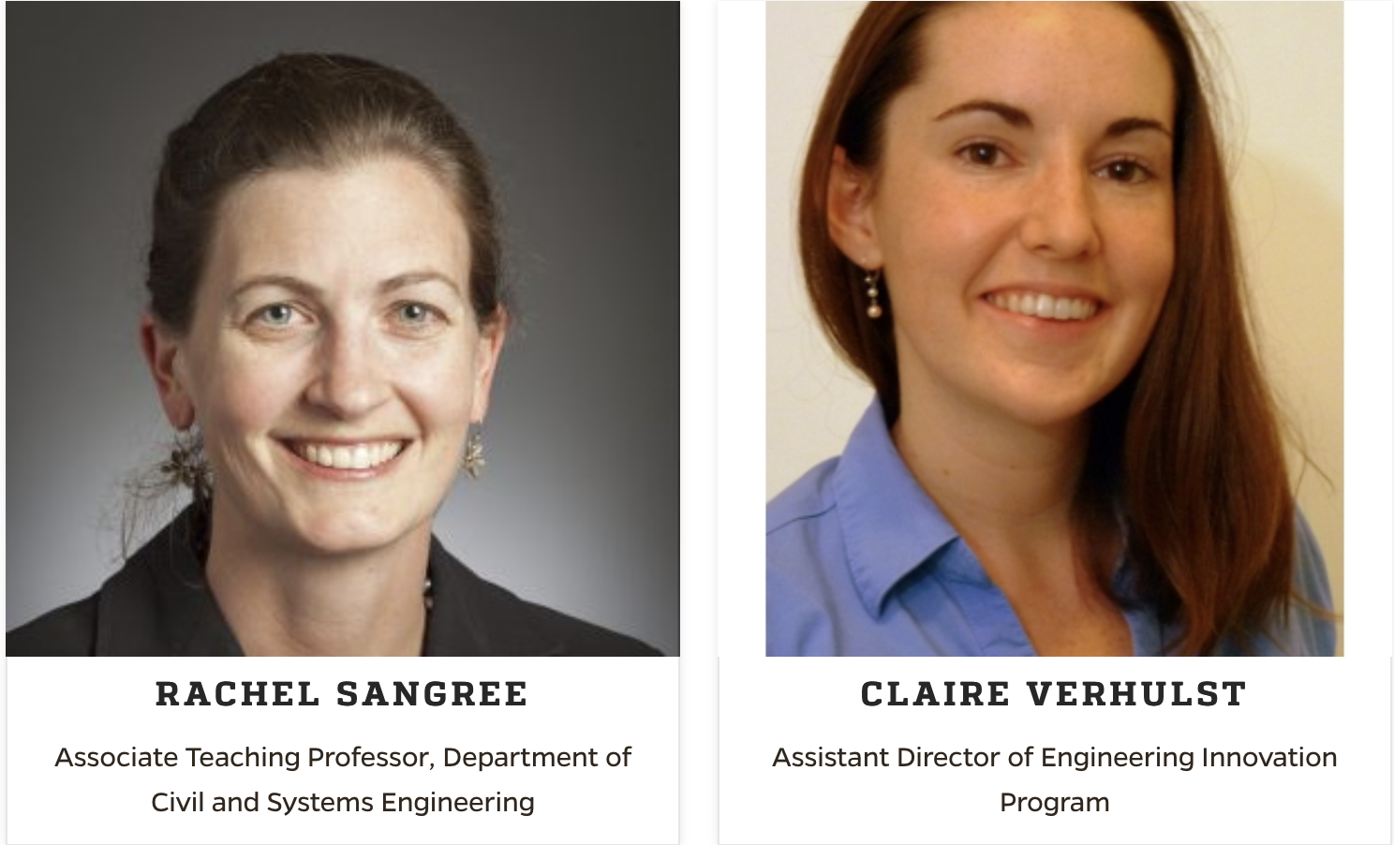
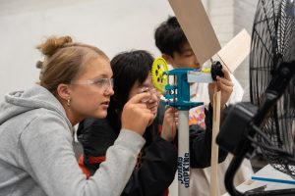
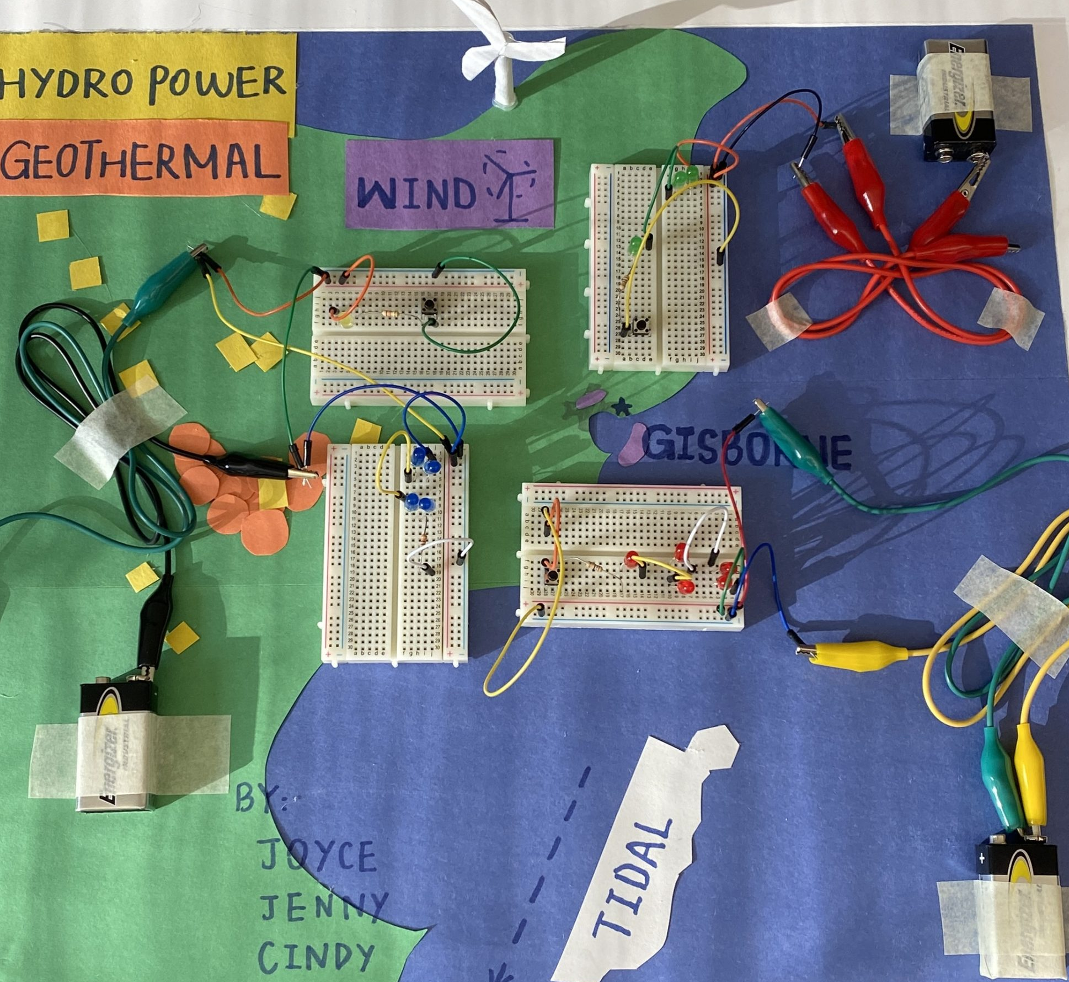
Pre-College offering:
Sustainable Energy Education (SEE): https://ei.jhu.edu/programs/see-in-person/
High school students
Part of Engineering Innovation Program
In-person and online options

Slide 11
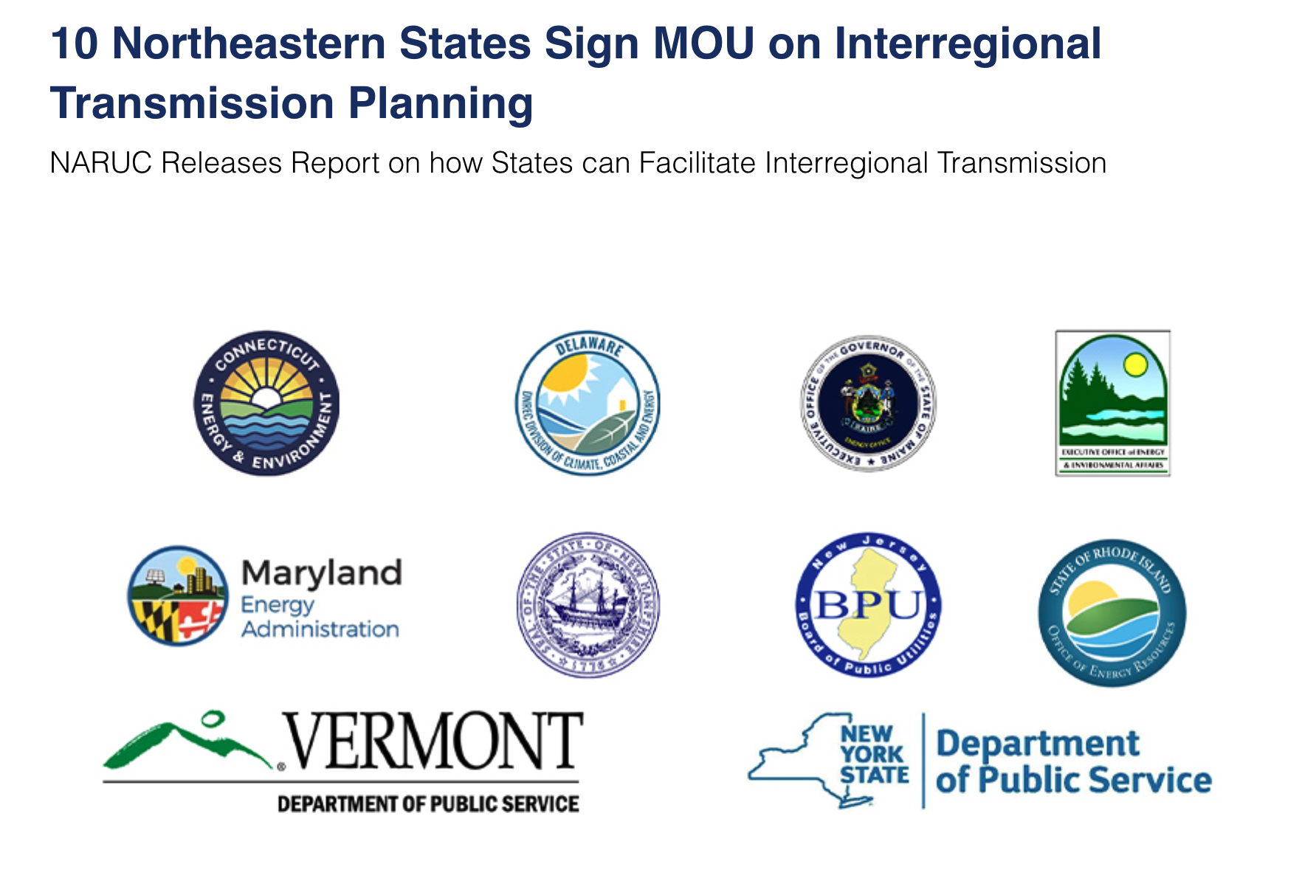
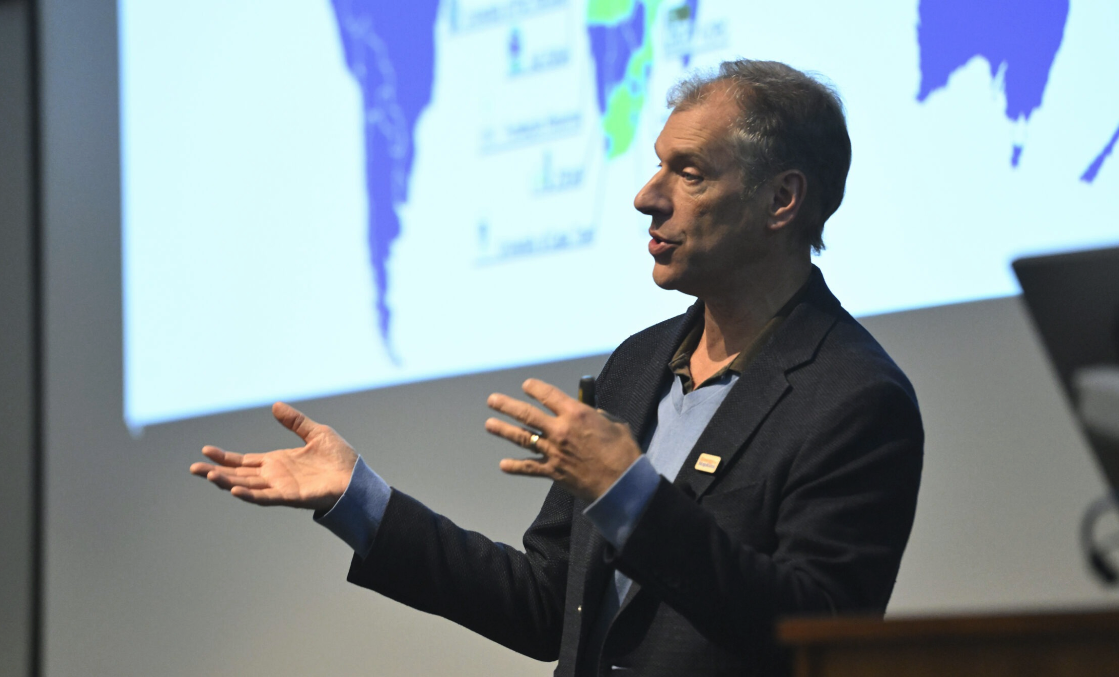
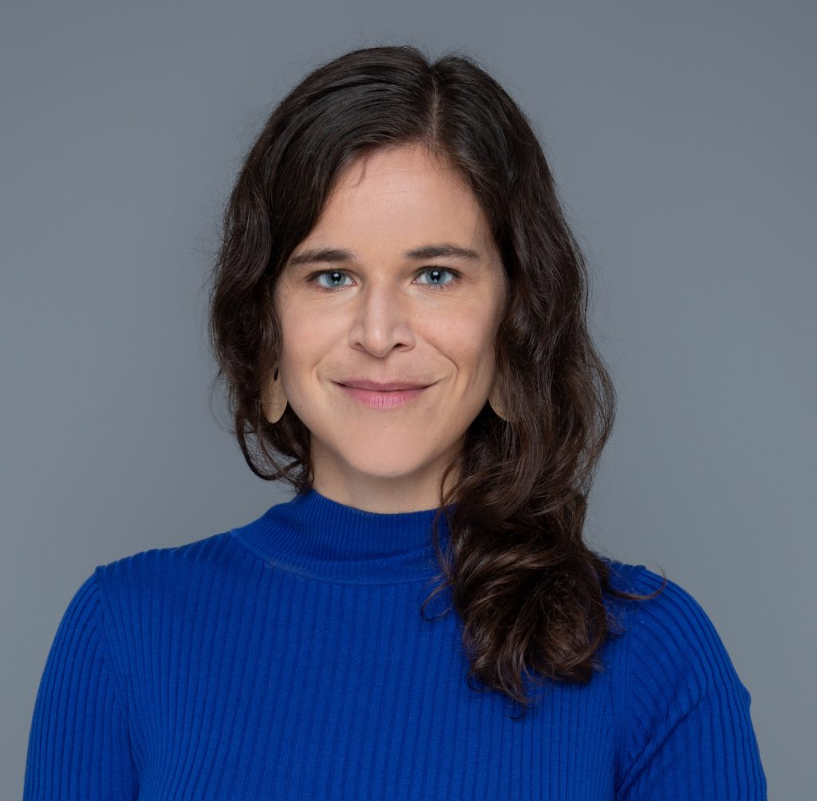
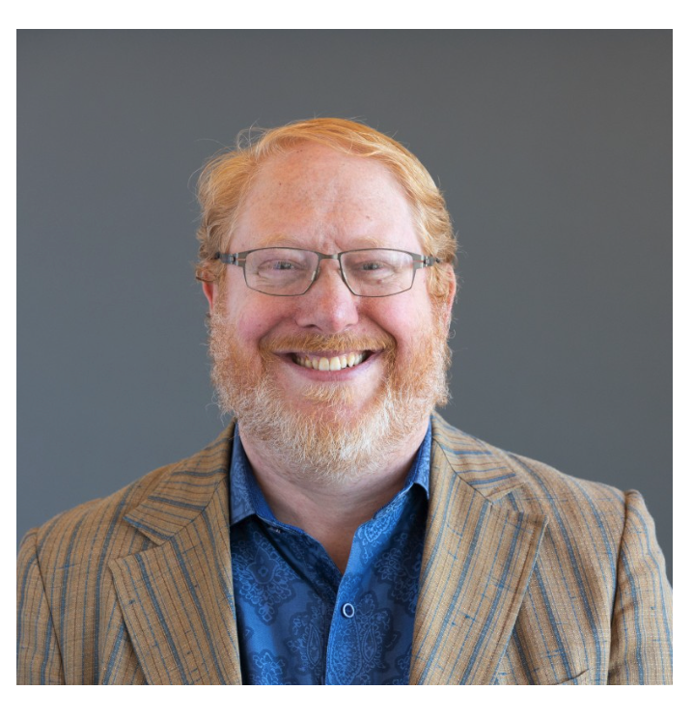
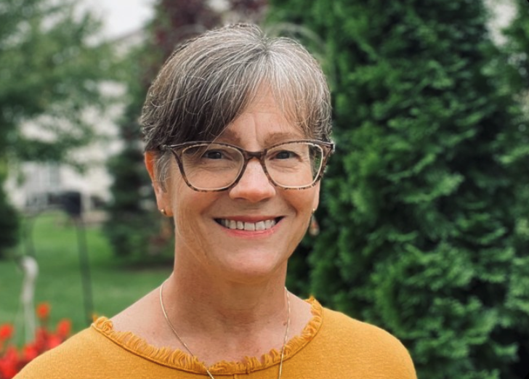
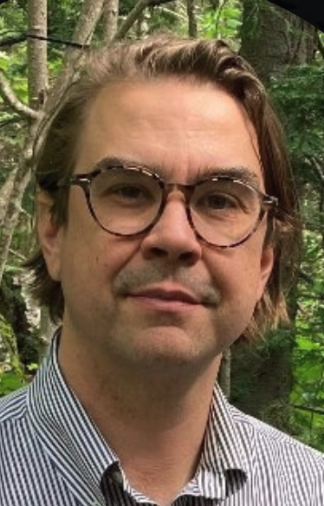



Impact – Policy: from Local to Global
New BDP
Kammen
New Asst. Prof.
Klemun
New Res. Scholar
Silverman
Consultant:
Glatz
Core Faculty:
Allan

Slide 12


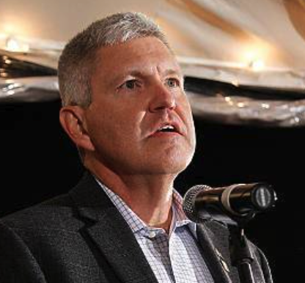
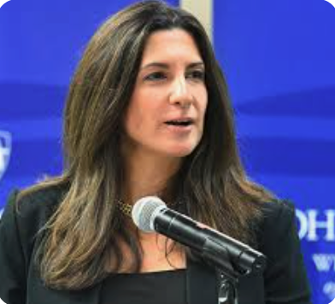
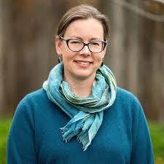

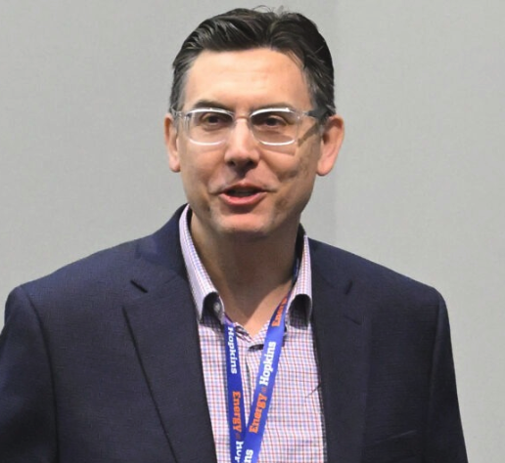


Impact-Partnerships
Consultant:
Cotton
Core Faculty:
Taheri
ROSEI BDP:
Lundquist
Partnership foci:
Sponsored funding proposals
Faculty joint-appts
Postdoc exchanges
APL REDD:
Maranchi

Slide 13


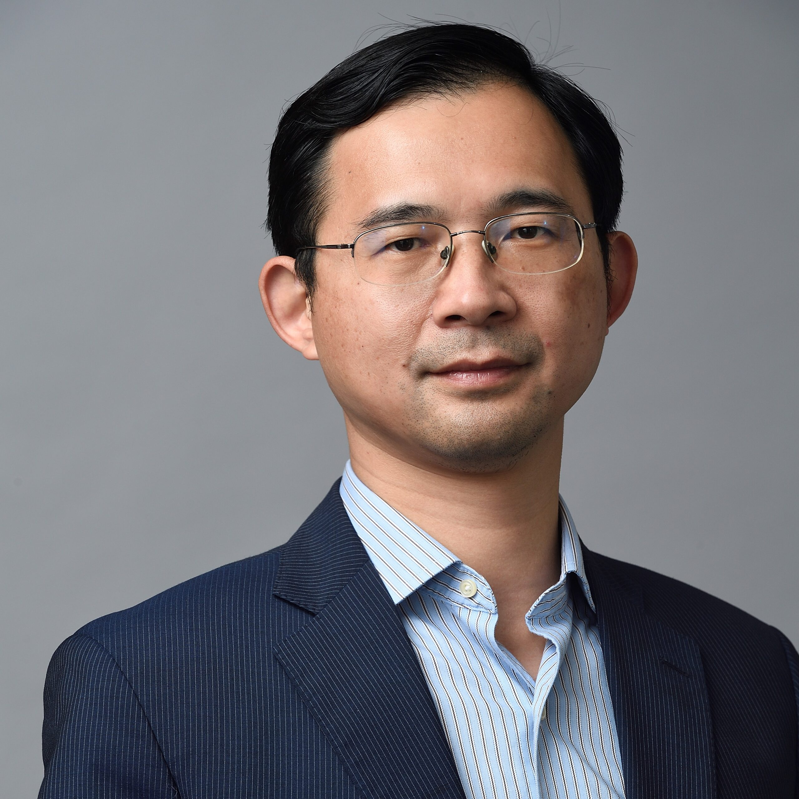
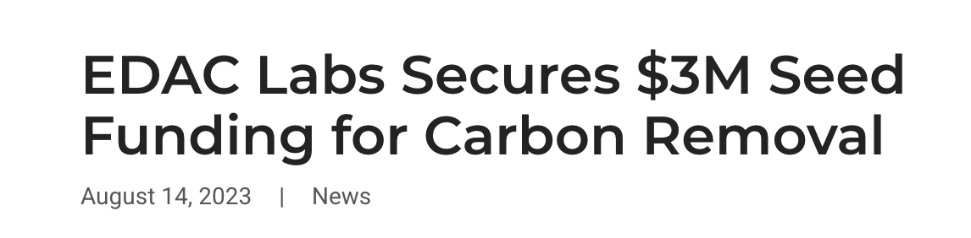
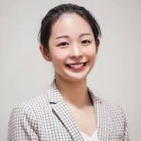
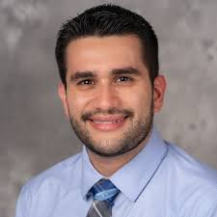
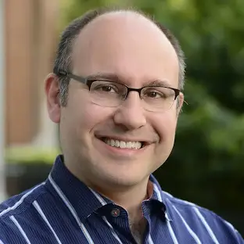


Impact- Translation
Core Faculty:
Wang
Next Generation of ROSEI Researcher/Entrepreneurs
Core Faculty:
Liu
Core Faculty:
Oses
Core Faculty:
Erlebacher

Slide 14
Wind
Atmospheric science, fluids, electrical
mechanical, and civil engineering for
efficient, scaled, reliable, renewable
power
ROSEI researchers work with national
labs and major OEMs to advance
controls, towers and solutions that
scale today for global needs
ROSEI wind farm simulation

Slide 15
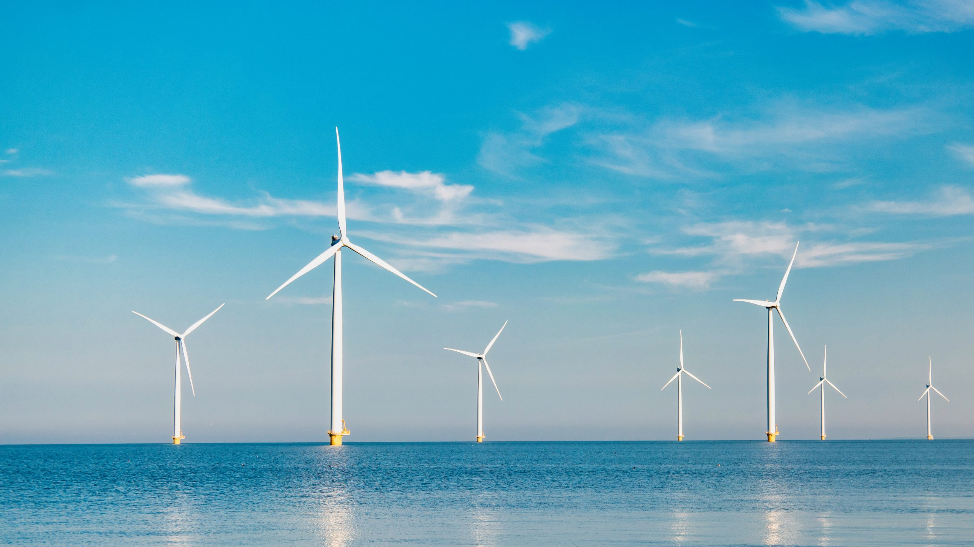





Prof. Sanjay Arwade
ARROW Director
Selected and under contracting negotiation - 25 February 2024 update
Empower, Engage, Innovate
Maryland
Energy
Administration

Slide 16
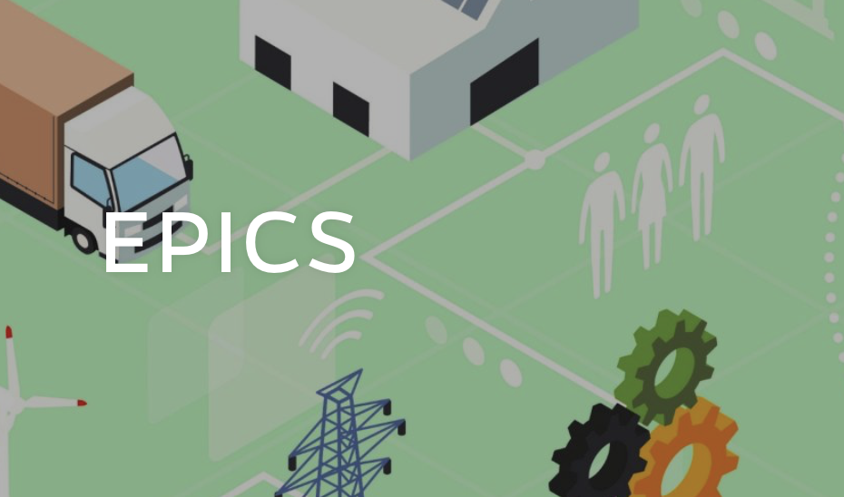

Grid
Power engineers, systems engineers, economists
and policymakers working towards full
electrification with renewable power and a transformed grid
ROSEI researchers established an NSF global climate change center and partner with ISOs to supply engineering and market solutions for a massively scaled up and dynamic power grid to deliver reliable power in an equitable fashion
NSF Global Center
Electric Power Innovation
for a Carbon-free Society

Slide 17

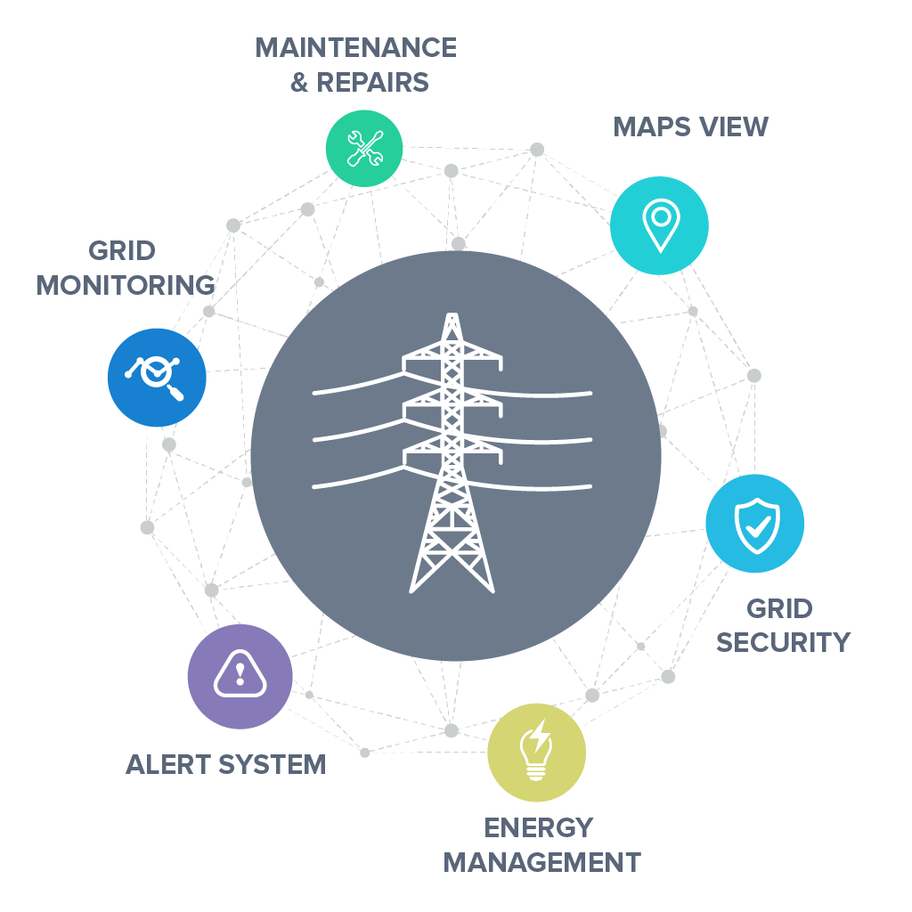
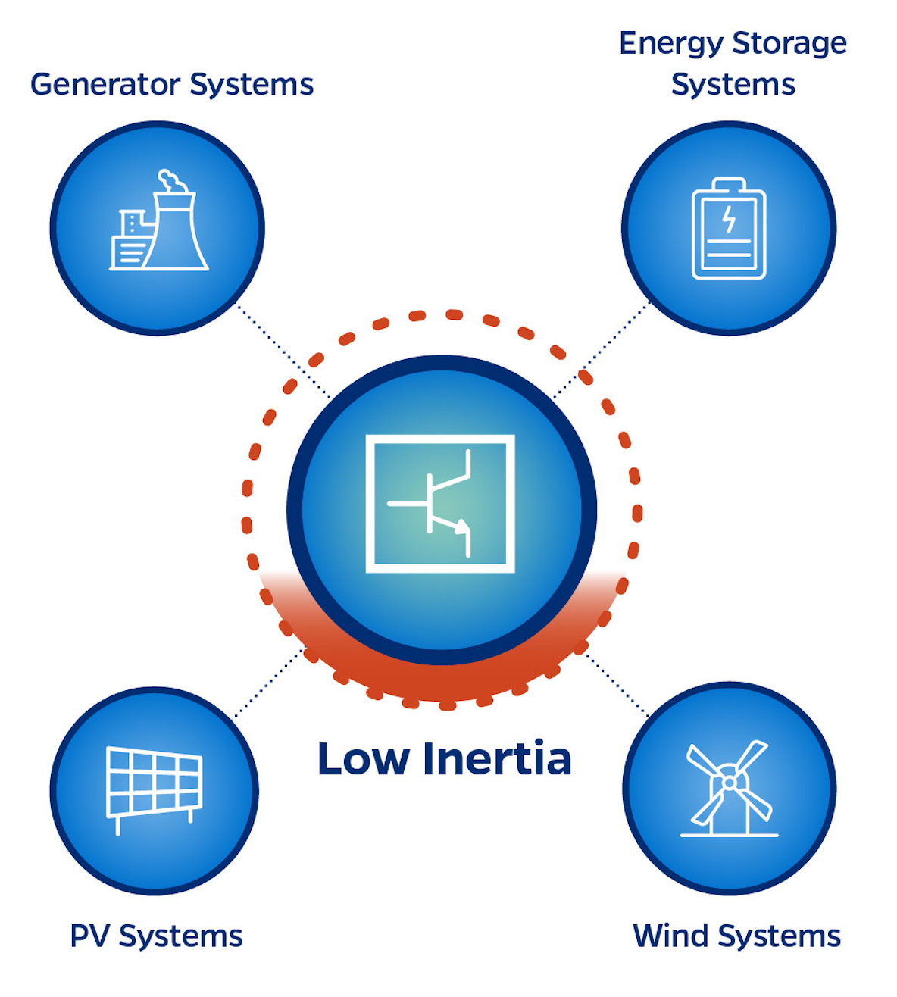
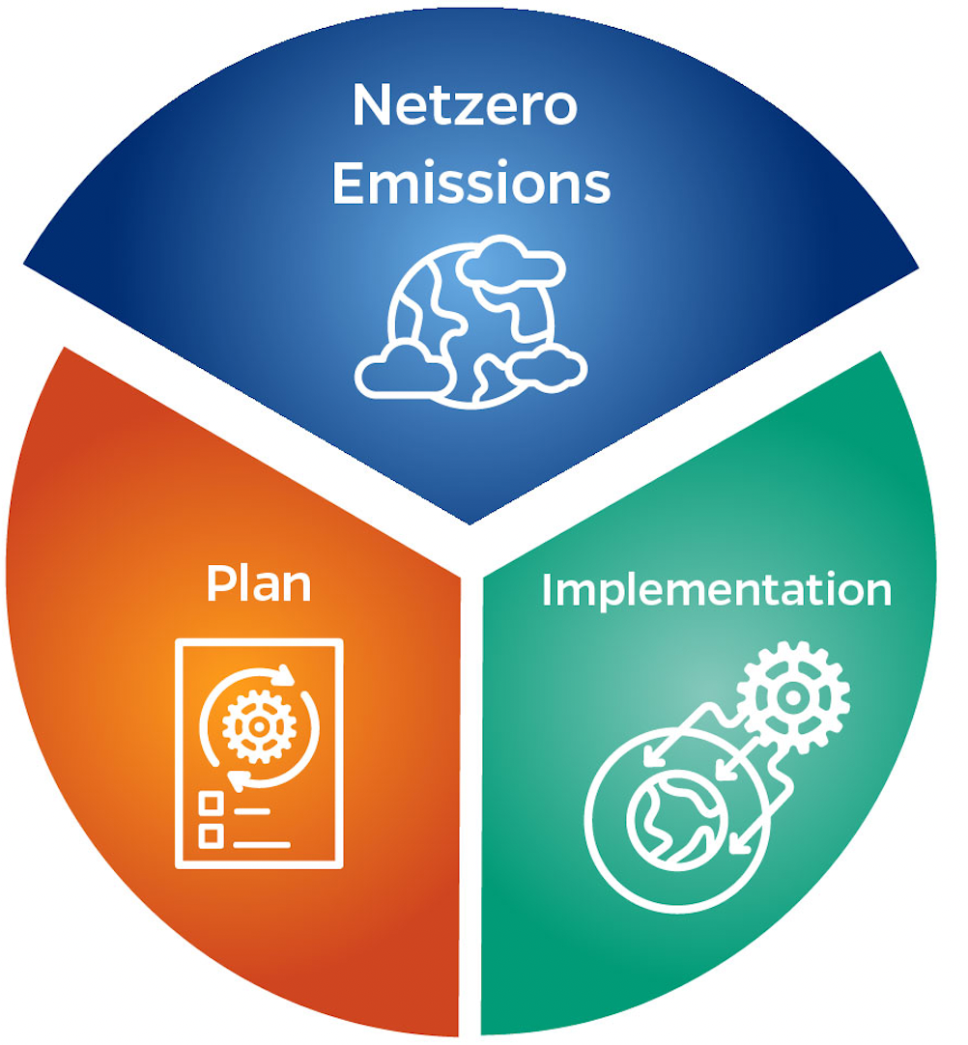




EPICS @ Hopkins
Data and ML for Grid
Low-inertia Grids
Future Electricity Market Design
Net Zero Transition
Strategic Global Partners (200+ engaged industry leaders)

